Slide 1
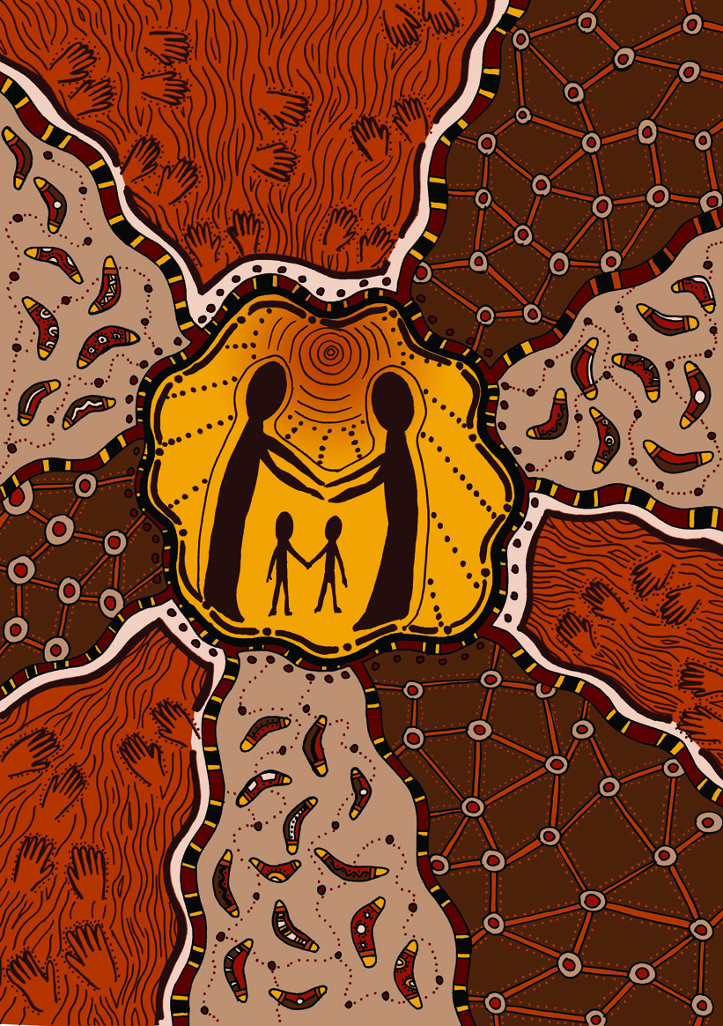
Cultural planning The new model
Notes:
The purpose of this PowerPoint to provide an overview of the processes involved in implementing the new cultural planning model.

Slide 2
Introduction
The CYFA establishes cultural support as essential for Aboriginal children in out-of-home (OOHC) care to maintain and strengthen their Aboriginal identity, and encourage their connection to their Aboriginal culture and community.
The case plan for an Aboriginal child in out-of-home care is required to address the child’s cultural support needs and reflect and be consistent with those needs. It contains significant decisions relating to the child. The child’s cultural plan includes various elements to promote, maintain and enhance the child’s connection to their Country and culture while they are in OOHC.

Slide 3
Background
In 2015 amendments to the CYFA were passed to strengthen permanency of care for children. These amendments included changes to case planning and cultural support planning for Aboriginal children.
In preparing for implementation of the amendments on 1 March 2016 the department engaged PricewaterhouseCoopers Indigenous Consultancy, the Commissioner for children and young people, ACCOs and community service organisations to co-design a new model for cultural planning.
Notes:
Prior to the amendments, cultural plans were only required for Aboriginal children subject to guardianship to Secretary or long term Guardianship to Secretary orders.

Slide 4
Background
The new model was funded in 2016/17, consisted of:
18 FTE Senior Advisors- Aboriginal Cultural Planning working within ACCOs to assist in the development, implementation and review of cultural plans
a state-wide co-ordinator
the development of a cultural online information portal
a .5 portal administrator
brokerage funding
a new template- which holds information about the child’s:
Identification
Cultural heritage
Strength of their existing cultural connections
Reflections of their own cultural history
Cultural aspirations
The new model assumes that everyone has a role in cultural planning and that Aboriginal people are best placed to provide cultural knowledge and inform decision making for Aboriginal children.
Notes:
VACCA has been funded to manage the statewide co-ordinator and portal.
The portal should be in operation later this year.

Slide 5
Principles of the new cultural planning model (1)
It is important that the cultural plan for children in OOHC, no matter the circumstances or permanency objective, is prepared as soon as possible, to maintain and encourage cultural connectedness.
For children who have a tenuous or no connection to their Aboriginal community and culture, providing opportunities to develop cultural connection offers the potential for an additional protective factor in their lives.
Where little is known about the child’s heritage, gathering information can be a goal of the first plan, along with goals and tasks to encourage development of the child’s general Aboriginal identity and connection.
Once further information is gathered, the plan can be reviewed to strengthen direct cultural and community connection.
Cultural plans will be developed by the care team with the support and oversight of the Senior Advisors – Aboriginal Cultural Planning and ACSASS.

Slide 6
Principles of the new cultural planning model (2)
A child’s cultural support needs, and therefore the scope of the cultural plan, varies depending on:
the length of time the child has spent in out-of-home care
the length of time the child is expected to remain in out-of-home care
the age of the child
the extent of the child’s contact with their Aboriginal family members
whether the child’s placement is within their own Aboriginal community, another Aboriginal community or with non-Aboriginal carers.

Slide 7
Roles and responsibilities Care team membership
The cultural plan is to be developed by the care team and led by the care team leader.
The members of a care team are the people who need to work together to jointly determine and do the things that parents ordinarily do to provide good care for a specific child in out-of-home care. A care team should always include:
the child’s CSO based care manager (who leads the care team)
the child’s case manager
the child’s primary carer(s)
the child’s parents (unless there is a very good reason not to include them)
any other adults who play a significant role in caring for the child including Aboriginal community member, grandparent, aunt, respite carer, Take Two practitioner, or disability practitioner.
The child’s CSO based care manager is identified by the CSO and may be a placement agency case worker, team leader, residential care house supervisor, kinship service worker or the CSO based contracted case manager.
In relation to residential care, the house supervisor /the staff member responsible for the overall care provided in the residential care household, must be a member of each child or young person's care team in the unit, in addition to the CSO based care manager if that is a different person.
If the child is in a departmental placement or a kinship placement and not receiving kinship support from a CSO, the child protection case manager is also the child’s care manager. The child’s case manager will be the allocated child protection practitioner or the CSO based contracted case manager (who would generally also be the CSO based care manager) or the CSO based case manager (if the child is not a child protection client, as may be the case for a child with a disability).

Slide 8
Allocated/contracted case practitioner tasks
Consult with the Senior Advisor – Aboriginal Cultural Planning* | Inform the Senior Advisor- Aboriginal Cultural Planning that an Aboriginal child has entered out-of-home care, and of the need to prepare a cultural plan. Use the tracker template to record the development of the cultural plan **
Convene a care team meeting (Where the placement is not provided by an ACCO or CSO - typically kinship care) | Members may include the Senior Advisor– Aboriginal Cultural Planning (where appropriate) and ACSASS if they indicate they wish to be involved. Aim for the strongest possible participation of Aboriginal people.
(Where an ACCO or CSO is Providing the placement - typically foster or residential care) | Ensure that the care manager, who leads the care team, convenes a care team meeting, including the Senior Advisor – Aboriginal Cultural Planning (unless they have indicated they will not participate in this part of the process), and ACSASS if they have indicated they wish to be part of the process.
Notes:
*As part of the consultation with the Senior Advisor – Aboriginal Cultural Planning, discuss:
the composition of the care team, including identifying Aboriginal people who are or could be part of the care team
information about the child’s and their family’s understanding of and connection to their Aboriginal community.
The Senior Advisor – Aboriginal Cultural Planning will determine if they need to be part of the care team developing the cultural plan, or if they will provide consultation as required. The Senior Advisor – Aboriginal Cultural Planning should be part of the care team if there is no other Aboriginal input into the care team.
*The tracker template should be used in supervision to track the development of the cultural plan.

Slide 9
Allocated/contracted case practitioner tasks …continued
Prior to the care team meeting: | Check and update cultural information for the child recorded in CRIS. Prepare a genogram for the child to at least three generations Print the ‘Child and Family Cultural Details’ document from CRIS and distribute as appropriate to the care team. Provide the care team with the case plan prior to or when the care team first meets about the cultural plan.
Arrange plan to be endorsed by the CEO of the ACCO and case planner | Request for the Senior Advisor - Aboriginal Cultural Planning arrange for their CEO to sign the cultural plan. (If the CEO requests amendments to the plan or additional information to be added, the plan will be returned to the care team for action. If there is an existing cultural plan, transfer it onto the new template and forward to ACCO for CEO endorsement.
Arrange endorsement by case planner | Seek endorsement by the team manager/ case planner. The case planner may request amendments to the plan and return the plan to the care team for action.
Provide a copy to the child and upload on CRIS | Once the plan is endorsed by the CEO, the cultural plan is provided to the child and a copy is uploaded on CRIS within 1 week.
Notes:
Genograms
Where it is not possible to develop a genogram to at least three generations, document on CRIS the genogram to the extent known and why a genogram has not been created to at least three generations.
Providing a copy of the plan to the child
For older children, these items can be given directly to the child. For younger children, these items should be given to the new carer or parent, with an explanation of their significance.
During implementation, maintain records in CRIS regarding:
cultural collection
cultural activities – socialisation and direct cultural connection
When the child changes placement or leaves out-of-home care, ensure any items or records significant to the child’s cultural journey, as well as a copy of the child’s most recent cultural plan, go with the child

Slide 10
Care team tasks
Convene a care team meeting | The care team leader must convene a care team meeting as soon as practical, and within two weeks of the child entering out-of-home care, to commence development of the cultural plan.
Engage with the child | Consider what the child wants and what they need to encourage/support their connection to their Aboriginal community and culture.
Engage with the child’s family | Engage with the child’s family, especially their Aboriginal family, to ascertain the family’s views and wishes on how to strengthen and maintain the child’s connection to their Aboriginal community and culture.
Develop the cultural plan | Work in a collaborative way to develop the cultural plan ensuring it aligns to the child’s case plan.
Implement the plan | The care team is responsible for ensuring the identified goals and tasks set out in the cultural plan are implemented.
Record keeping | Keep record of cultural activities using the cultural activities log.
Notes:
16 week timeline is the maximum period in which a cultural plan should e completed. Attempts should be made to complete the plan before this time.

Slide 11
Senior advisor - Aboriginal cultural planning - tasks
Be part of each care team where there is no other Aboriginal person in the care team or support is required | Consult with the case manager no later than 3 business days after being notified that an Aboriginal child has entered out-of-home care.
Contribute to care team meetings | Advise the care team leader in writing if you will provide consultation and support only, rather than being part of the care team, including the rationale for this decision, and advising how you will assist.
Actively participate in drafting and reviewing cultural plans | Help prepare the first cultural plan for an Aboriginal child, giving priority to cases where potential barriers to cultural planning or particular vulnerabilities have been identified.
Be part of care teams developing or reviewing a plan where: | there is no Aboriginal person in the care team there has been minimal or no progress on the goals and tasks of the cultural plan, or at the request of the CEO of the ACCO, or the child’s case planner
Provide the final cultural plan to the CEO of your ACCO without delay, for endorsement | Where a cultural plan has been returned to the care team by the CEO, ensure the care team understand any changes or additional elements required, and work with the care team to make these changes as quickly as possible.
Notes:
Consultation with the Senior Advisor must consider membership of the care team, especially relating to identifying an Aboriginal person confident of being able to provide meaningful input into the care team.

Slide 12
ACCO Chief Executive Officer tasks
Review and approve the cultural plan | Ensure that: the information is accurate, to the best of the ACCO’s knowledge the genogram is as complete as possible at the time cultural information is thorough appropriate tasks have been planned to provide the child with the best possible information about their family and cultural connection activities proposed provide a real opportunity for cultural connectedness.
If the cultural plan is not ready for signing (i.e. missing or unavailable information or strategies are inadequate) | Return the cultural plan to the care team with specific information explaining what changes or additional elements are required. Set a date for the next review of the cultural plan.
Set a date for the next review of the cultural plan. | Generally, cultural plans should be reviewed annually (in-line with the case plan if possible). However, there may be individual circumstances where a shorter time frame may be more appropriate.
Endorse the plan | Once you are satisfied that the cultural plan is appropriate at this point in time, sign the plan and forward to the child’s case planner within two weeks of receiving the plan for endorsement.
Notes:
Generally, cultural plans should be reviewed annually (in-line with the case plan if possible). However, there may be individual circumstances where a shorter time frame may be more appropriate, such as where: specific parts of the plan are incomplete despite best efforts and a shorter time frame for review may promote its completion, such as where a genealogy search is required therapeutic interventions are planned that may assist with addressing barriers to cultural connectedness for the child.

Slide 13
Case planner/ Team manager tasks
Review the cultural plan signed by the ACCO CEO | Ensure: the cultural plan is aligned to the case plan the goals and tasks contained in the cultural plan are financially viable any financial commitments are funded.
Endorse the cultural plan | When the above conditions have been met
Negotiate changes if required | If any change is required consult with the ACCO CEO and care team to negotiate a suitable outcome.
Endorse the plan | Endorse the cultural plan and arrange for a copy to be provided to the child within one week of the date of endorsement by the ACCO CEO.

Slide 14
Timelines

Slide 15
Key performance indicators
Cultural plans must be completed ready for endorsement within 16 weeks of the child entering out-of-home care.
A further three week period is provided to support endorsement of the plan by the Chief Executive Officer of the ACCO. The cultural plan timelines provide details of the process for the drafting and endorsement of cultural plans.
Key performance indicators to monitor the program objectives:
KPI1: Number of endorsed cultural plans where the Senior Advisor - Aboriginal Cultural Planning has direct input (direct input could include case consultation, providing information or attending a care team meeting).
KP2: Number of endorsed cultural plans uploaded into CRIS as a proportion of the number of cultural plans required.
KP3: Time taken to give an endorsed cultural plan to the child from entry into out-of-home care.

Slide 16
Brokerage
Members of the care team and the Senior Advisor Aboriginal Cultural Planning can make recommendations to case planners to fund activities, experiences or resources to connect a child to their Aboriginal community and culture.
Such activities may include:
• cultural sports
• community events/celebrations
• recreational activities
• activities that support children in maintaining contact with their family and community
• access to Aboriginal holiday programs
• learning materials
• healing camps
• access to the arts
• return to Country
Decisions regarding the allocation of client brokerage remain with the case planner who is responsible for ensuring the goals and tasks contained in plans are financially viable.
Additional brokerage is also available for return to Country, through the Roadmap for Reform Out-of-home Care South Initiative.

Slide 17
Resources/contacts
Senior Advisor - Aboriginal Cultural Planning practitioners are located in the following ACCOs:
Division | Local Area | Agency
North | Nth East Melbourne | Victorian Aboriginal Child Care Agency (VACCA)
 | Hume / Moreland | VACCA
 | Loddon | Bendigo & District Aboriginal Cooperative (BDAC)
 | Loddon | Njernda Aboriginal Corporation
 | Mallee | Mallee District Aboriginal Services Ltd (MDAS)
South | Cheltenham | VACCA
 | Frankston | VACCA
 | South Melbourne | VACCA
 | Outer Gippsland | Gippsland & East Gippsland Aboriginal Corporation (GEGAC)
 | Inner Gippsland | Ramahyuck
East | Inner Eastern Melb | VACCA
 | Outer Eastern Melb | VACCA
 | Goulburn | Rumbalara Aboriginal Cooperative
 | Ovens Murray | Mungabareena Aboriginal Cooperative
West | Western Melb | VACCA
 | Brimbank Melton | VACCA
 | Barwon | Wathaurong Aboriginal Cooperative
 | Central Highlands | Ballarat & District Aboriginal Cooperative
 | Wimmera | Goolum Goolum Aboriginal Cooperative
 | South West | Gunditjmara Aboriginal Cooperative

