Slide 1
Responding to the wellbeing and safety of children
Community Education Pack
OFFICIAL

Slide 2

Acknowledgement of Traditional Owners
The Victorian Government proudly acknowledges Victorian Aboriginal people as the First Peoples and Traditional Owners and custodians of the land and waters on which we rely.
We acknowledge the ongoing leadership role of the Aboriginal community in creating services and supports to ensure that all Aboriginal children are raised in safe, healthy and culturally rich families and communities and have every opportunity for a bright future.
We pay our respects to ancestors of Country, Elders, knowledge holders and leaders - past, present and emerging.

Slide 3
Recognising Lived Experience
We acknowledge victim survivors of family violence and other forms of childhood abuse for whom we do this work.
We also acknowledge anyone here with lived experience and acknowledge the challenge of presenting our professional and personal selves in this space.
We also acknowledge the lived experience of children and young people who experience family violence and the lifelong impact of these experiences on their development, safety, wellbeing and future relationships.
When we acknowledge children and young people as victim survivors in their own right, as professionals who work with them, we can provide targeted support and interventions needed to break the cycle of violence and nurture their healing.

Slide 4
Welcome and Key Messages
Everyone is responsible for supporting and protecting children and young people
Victoria's service continuum is a three-tiered system. Universal, Secondary and Tertiary.
A key part of your role is to know the right service to contact when you have concerns about a child or young person.
This presentation will help you:
understand how you can respond if you have wellbeing concerns or concerns for the safety of a child and/or young person
getting the right support at the right time for children and families
understand the role and function of The Orange Door
understand the role of Child Protection and mandatory reporting
identify pathways for supporting Aboriginal Self Determination

Slide 5

Agenda
1. Victoria's Approach to Supporting and Protecting Children
2. Supporting Aboriginal self-determination
3. The Orange Door: role and function
4. Child Protection: role and function
5. To Refer (to The Orange Door) or To Report (to Child Protection)
6. Mandatory Reporting and other Reporting Requirements
7. Making a Report to Child Protection
8. Information Sharing and MARAM Framework
9. Case Study Examples
10. Reporter Hub

Slide 6
Victoria’s Approach to Supporting and Protecting Children

Slide 7
Victoria’s Service Continuum
Police
Child Protection
Care Services
Aboriginal Children
in Aboriginal Care (ACAC)
Childcare
Preschools
Maternal & Child Health
Neighbourhood Houses
Telephone counselling
GPs | Schools
Community Health Centres
The Orange Door | ACCOs
Parent Services | Family Services
Drug & Alcohol Services
Mental Health Services
Early Intervention Services
Specialist Children’s Services
Family Violence & Sexual Assault Services
School Focussed Youth Services
Tertiary Services
Protecting children is everyone’s responsibility
Secondary Services
Universal Services

Slide 8
Supporting Aboriginal Self Determination

Slide 9

Self-Determination
“Self-determination is an ongoing process that ensures the continuance of choice, participation, decision making and control over one’s destiny; it involves the freedom to live well, humanly and respectfully according to values and beliefs. It includes the notion of a collective identify of Aboriginal peoples. It requires recognition and support with appropriate representation at all levels of society”
(UN International Covenant on Civil and Political Rights)
“Without self-determination it is not possible for Indigenous Australians to fully overcome the legacy of colonisation and dispossession”
(Australian Human Rights Commission, 2003)
“Self-determination in practice for Aboriginal Community-Controlled Organisations (ACCOs) means that services for First Nations people are designed, controlled, and delivered by Aboriginal people, ensuring cultural authority, strengthening communities, and ensuring accountability to local communities rather than just government.”
(National Agreement on Closing the Gap)

Slide 10

Legacy of colonisation in Australia
Aboriginal history is recorded at least 60,000 years prior to European contact and encompasses many diverse communities of Aboriginal people who not only survived but thrived.
The impact of colonisation has had profound and enduring impacts on many Aboriginal people; this continues today and is known as intergenerational trauma.
These impacts of policy as well as successive legislation has occurred from 1869 until 1966 in Victoria resulted in the forced removal of children from their families and prohibition of language i.e. culture.
As a result, Aboriginal children and young people are significantly over-represented in the Victorian out-of-home care system, due to the loss of identity, connection to family, community and Country.
Numbers continue to grow at a more significant rate than non-Aboriginal children and young people.
Notes:
Taken from WG

Slide 11
Aboriginal Children in Aboriginal Care (ACAC)
The Aboriginal Children in Aboriginal Care (ACAC) program gives authorised Aboriginal Community-Controlled Organisations (ACCOs) – under section 18 of the Children, Youth and Families Act 2005 – legal responsibility for Aboriginal children or young people who have been placed on a Children’s Court protection order, including IAOs and TTOs.
Under this program, an authorised ACCO will actively work with the child’s family, community, and other professionals to develop a case plan to address protective concerns and achieve long-term objectives in a way that is culturally appropriate and in the best interests of the child.
The expansion of the ACAC program, recognises that Aboriginal people and organisations are best placed to make decisions and deliver services that protect the best interests of Aboriginal children.
The department supports empowering ACCOs to make decisions that deliver better outcomes for First Nations children and families.
Aboriginal Children can only be referred by Child Protection to an ACCO delivering ACAC.

Slide 12
Authorised Aboriginal Children in Aboriginal Care programs
Aboriginal Children in Aboriginal Care is a program for Aboriginal children and families involved with the child protection system where authorised Aboriginal Community Controlled Organisations provide vital child safety services.
Nugel Program
Victorian Aboriginal Child and Community Agency
Mutjang Bupuwingarrak Mukman Program
Bendigo and District Aboriginal Cooperative
Ballarat and District Aboriginal Cooperative
Galnya Yarka Program
Gobata Burron Program
Rumbalara Aboriginal Cooperative
Loddon
Goulburn
North Metro
South Metro
Inner Gippsland
Ovens Murray
West Metro
Central Highlands

Slide 13
Pre-Authorisation Aboriginal Children in Aboriginal Care programs
ACCOs undertaking the ACAC pre-authorisation phase will operate ‘as if’ authorised under section 18 of the CYFA to undertake specified functions and powers in relation to a Children’s Court protection order or other order for an Aboriginal child or young person or for the sibling of an Aboriginal child authorised to the ACCO. The pre-authorisation phase, like the ACAC program, recognises the needs of Aboriginal children are best met by Aboriginal community services that are culturally attuned. ACCOs are also best placed to reconnect Aboriginal children and families to culture where there has been a disconnection.
The ACCO is responsible for managing the child’s protection and/or relevant order and any court ordered conditions. The ACCO oversees all day-to-day decision making for the child and be responsible for their safety.
Child protection will retain ultimate responsibility for case planning and court activity for children involved with the ACAC pre-authorisation phase, as required by legislation. The ACAC pre-authorised provider will have significant influence and input into these elements. Child protection will, except in exceptional circumstances, act on the case planning recommendations put forward by the ACAC pre-authorised provider.
Preauthorisation is a time for ACCOs to develop their confidence and capabilities in statutory work and develop their unique practice approach for example, this may include policies and operational guidance, specific to their community.
Currently, two ACCOs are in preauthorisation:
Gippsland and East Gippsland Aboriginal Cooperative (GEGAC)
Goolum Goolum Aboriginal Co-operative

Slide 14
Children and Health Legislation Amendment (Statement of Recognition, Aboriginal Self-determination and Other Matters) Act 2023
The Statement of Recognition Act passed Parliament on 20 June 2023 and makes changes to improve responses to Aboriginal children and their families involved with Child Protection and family services. It will ensure the distinct cultural rights of Aboriginal people and their right to self-determination are recognised, respected and supported.
The Act:
introduces a Statement of Recognition that acknowledges that laws, practices and policies have driven the over‐representation of Aboriginal children in the Child Protection system and commits the system to recognise and support the distinct cultural rights and self‐determination of Aboriginal people
introduces binding principles in the Children, Youth and Families Act 2005 requiring decision-makers under the children and families provisions to have regard to, and act in a way that upholds, the principles when making a decision about, or providing a service to, an Aboriginal child
legislates all five elements of the Aboriginal Child Placement Principle (ACPP): prevention, partnership, placement, participation and connection (previously only reflected in policy)
enables the effective functioning of Aboriginal Children in Aboriginal Care (ACAC) by expanding the functions that can be authorised to Aboriginal-led agencies
removes outdated language from Child Protection legislation

Slide 15
The Statement of Recognition Act and ACAC: Community Protecting Boorais
The Statement of Recognition Act expanded authorisation to the Aboriginal Children in Aboriginal Care (ACAC) program to include ACAC providers to undertake investigative functions and powers known as Community Protecting Boorais program. Allowing for earlier intervention by ACCOs in an Aboriginal child and family’s journey.
Community Protecting Boorais program
An Australian first, the Community Protecting Boorais program allows authorised ACCOs to take responsibility for investigating reports that are made to child protection for Aboriginal children and non-Aboriginal siblings.
The program aims to reduce the over-representation of Aboriginal children in care, by prioritising self-determination and facilitating Aboriginal models of care delivered by ACCOs.
The Victorian Aboriginal Child Care Agency (VACCA) and Bendigo and District Aboriginal Cooperative (BDAC) lead the program, which started in 2023 – in an extension of their involvement in the ACAC program for many years. They respond to child protection reports, thereby intervening earlier to try to divert families from further entering the child protection system
Notes:
Potential QandA on ACAC and CPB
How does an ACCO become authorised to deliver ACAC?
For ACAC, as set out in section 18 of the CYFA, the Secretary of DFFH can authorise an ACCO’s Chief Executive Officer to assume specific functions and powers in relation to a Children’s Court order for an Aboriginal child or young person or their siblings.
For Community Protecting Boorais, this extends to functions and powers relating to investigating a report made to child protection.
This means that once a decision to investigate a report has been made by child protection, or an order for an Aboriginal child or young person has been made by the Children’s Court, an approved ACCO may be authorised to take on all authorised statutory responsibility and decision making for the child’s case management and case plan.
What do ACCOs need to do?
To become fully authorised, an ACCO will need to complete a period of pre-authorisation for a minimum of 12 months.
This period of pre-authorisation includes meeting certain program requirements that will allow ACCOs to administer child protection orders. While the program requirements will include legislative and policy conditions, authorised ACCOs will develop their own Aboriginal practice approach in line with the ACAC program. This approach allows ACCOs to connect Aboriginal children and families to culture, where there has been a disconnection, and to make decisions about the child in line with self-determination and from a cultural lens. Part of this approach is to develop and use language to promote change; both within the family and the broader service system.
The program requirements are co-designed by ACCOs, DFFH and the Commissioner for Aboriginal Children and Young People. A dedicated team in DFFH works with ACCOs to assist in the implementation of the ACAC program.
What are the key responsibilities for the ACAC program?
If the Children’s Court makes an order in respect to an Aboriginal child, an authorised ACCO may take on the responsibility of developing and implementing the child’s case plan.
The ACCO will be responsible for managing the child’s protection order and any court ordered conditions. They will also oversee all day-to-day decision making for the child and be responsible for their safety.
Community Protecting Boorais
The Community Protecting Boorais program authorises a child under section 18 (1)(b) of the CYFA. This section does not require DFFH and ACCO to consider the views and wishes of the child and child’s parents. This will enable the Community Protecting Boorais program to engage with Aboriginal children and families in a timely manner to ensure safety and determine what supports or action may be needed.

Slide 16
Aboriginal Restoring Families programs
Highlights​
Over 1000 Aboriginal families supported each year. ​
ACCOs are one of the primary connection points for Aboriginal families across the platform​
Supports are culturally led and informed. Cultural elements have been built into ACCO designed evidence-based practice
Aboriginal Restoring Families provides culturally informed, intensive, evidence-based support to families with multiple, persistent and complex challenges and needs. Interventions work in partnership with statutory, universal and specialist services to:
Divert children from statutory systems
Reunify children in care with their families
Support families to secure children’s safety, development, and wellbeing
Connect families to support culture and community
This service response includes ACCO-designed rapid diversion and support models implemented in each DFFH Area statewide. Some local Aboriginal-led models include:
Aboriginal-led Case Conferencing​
Short-term intensive support for families subject to a CP Intake report.
Concerns and support needs are explored in family led case conferencing and then the right referrals are made for the family.
78.3% of cases resulted in a diversion from further statutory engagement.
Bringing up Aboriginal Babies at Home
Intensive case management for pregnant women and their partners as early as possible after an unborn CP report is made, and up to 6 months after birth.
Early information suggest a high rate of success, with further evaluations to occur.

Slide 17
The Orange Door
Role and Function

Slide 18

The Orange Door
The Orange Door is a free, accessible community entry point. It provides information and support to people of all ages experiencing or choosing to use family violence; and children, young people and families seeking parenting and wellbeing support.
The Orange Door welcomes people of any age, gender, sexuality, culture and ability.
Who works at The Orange Door?
The Orange Door brings together Community Service Organisations and DFFH as a multiagency partnership consisting of Family Violence services (victim survivor and adult using family violence), Family Services, Aboriginal Community Controlled Organisations and Community Based Child Protection to provide integrated intake and assessment across the state.

Slide 19
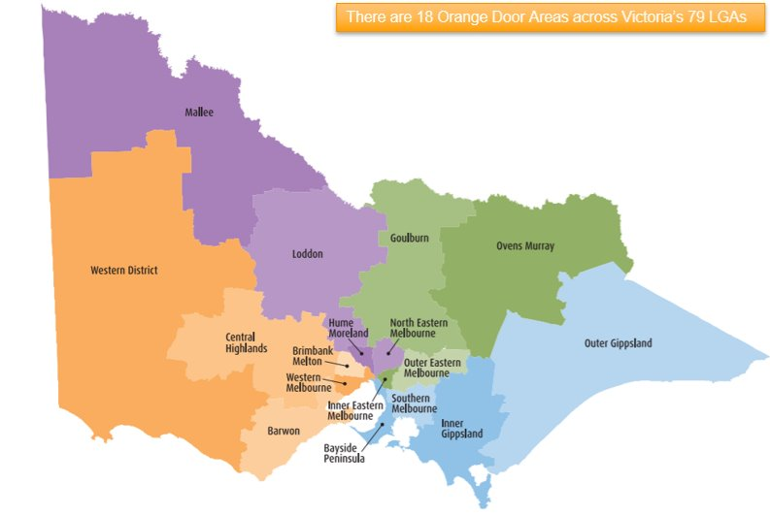
The Orange Door Locations
There are 18 Orange Door primary sites across Victoria with 19 access points and outposts, making it easier for people to get help close to home

Slide 20
How does The Orange Door provide Information and Support
What does The Orange Door provide? Initial contact and support Screening, identification and triage Crisis response Family violence risk and needs assessment Child and young person wellbeing risk and needs assessment Safety planning Service planning Secondary consultations Referrals to meet longer term needs | How are referrals made to The Orange Door? The Orange Door receives referrals from a range of sources including Victoria Police (Family Violence L17 referrals), Child Protection and other professionals. Families and individuals (including young people) can access The Orange Door directly by calling, emailing or attending their local Orange Door between 9am – 5pm Monday to Friday. No appointment or referral is needed.

Slide 21
The role of The Orange Door?
How does The Orange Door respond to a referral?
Each person (including each child and young person) is assessed individually. This ensures each member of the family/referral receives a response tailored to their unique needs.
Practitioners work together in integrated teams to keep the whole family in view by sharing relevant information and coordinating service provision.
This integrated service response is supported by case consultation, Team Leaders and Practice Leaders and information sharing enabled by Part 5b of the FVPA and information sharing schemes.
How does The Orange Door support Aboriginal people?
The Orange Door supports the choice and self-determination of Aboriginal people as the First Peoples of Australia and works closely with Aboriginal communities and services to ensure they receive culturally safe and appropriate services that meet their needs.
Referrals that identify a person as Aboriginal are assigned to the Aboriginal responses team unless the person expressly asks that their information is not shared with other community members. Self-referring Aboriginal people can choose whether they would like a response from an Aboriginal or non-Aboriginal response team.
What is Integrated Practice?
For clients, this means telling their story once, experiencing greater consistency and trust, and being connected to the right supports at the right time. Integrated practice transforms a collection of separate services into a unified response—centered on safety, wellbeing and accountability for people and families in our community.

Slide 22

Client Journey through The Orange Door

Slide 23
Secondary Consultation with The Orange Door
Professionals can seek advice or a secondary consultation from The Orange Door.
This can include:
whether a referral to The Orange Door is appropriate
what support services are available
how to support families experiencing or using family violence
how to support families seeking support with the care, wellbeing and development of a child or young person
how to support children or young people whose wellbeing and developmental needs are not being met at home.
Note: If The Orange Door determines that a REPORT to Child Protection or Police is more appropriate than a REFERRAL to The Orange Door, they will tell you to make a REPORT to the relevant authority.

Slide 24





How to contact The Orange Door
The Orange Door is a free service and operates during business hours (9am to 5pm) from Monday to Friday (closed public holidays). You do not need a referral or an appointment. You can attend in person or reach out by phone. It also means that if a person wants to go directly to a service for help, they can do so.
Telephone (9am-5pm Mon-Fri) https://www.orangedoor.vic.gov.au/contact-us
Online: Find the closest location to you at https://www.orangedoor.vic.gov.au/support-near-you
Email addresses are area specific
Primary sites and access points (9am-5pm Mon-Fri) - no appointment needed. Outposts by appointment only (not listed on website location finder)
Outreach workers, who can engage people where they feel comfortable

Slide 25
Child Protection
Role and Function

Slide 26
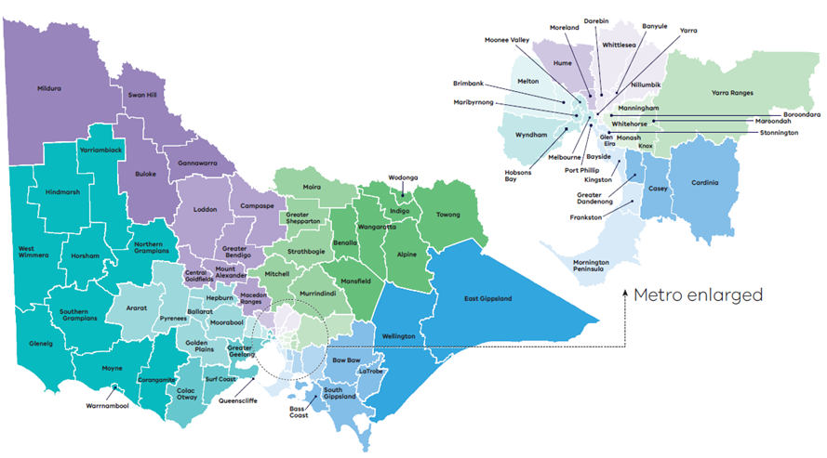
Child Protection in Victoria
Children, Youth and Families Act (CYFA) 2005 outlines the statutory role of Child Protection
Child Protection is delivered across 17 DFFH areas within 4 divisions Victoria
Statewide Intake receive all Child Protection reports from 8:45am - 5pm, Monday to Friday.
Child Protection After Hours Service receives reports outside of business hours. Including weekend and public holidays.

Slide 27
Core Responsibilities of Child Protection
Receives reports for children and young people under 17 ​years and unborn children
where a child may be in need of protection AND parents have not protected or are unlikely to protect their child​
OR
there are significant concern for a child’s wellbeing or unborn child
Receives reports for children aged between 10 to 18 years who exhibit sexually abusive behaviours and in need of therapeutic treatment​
Child Protection will:
Assess risk of harm
Investigate reports classified as protective intervention reports
Develop case plans where harm has been substantiated
Refer families to support services​
Apply for protection orders from the Children’s Court​
Supervise children on protection orders until the order expires or their 18th birthday

Slide 28
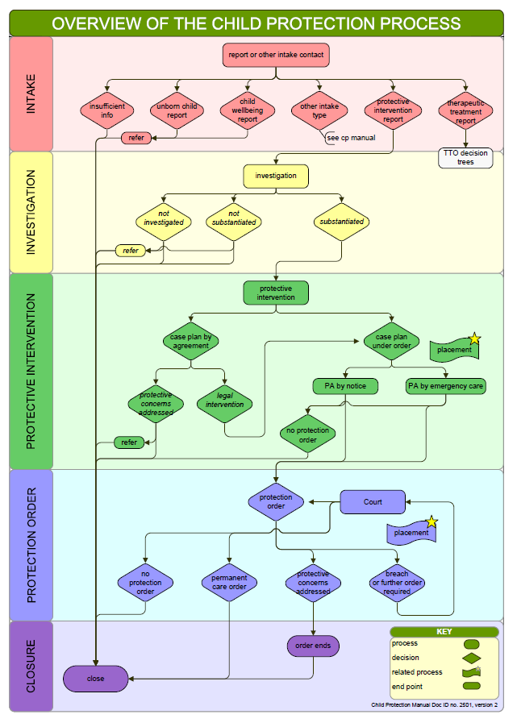
Child Protection Process

Slide 29
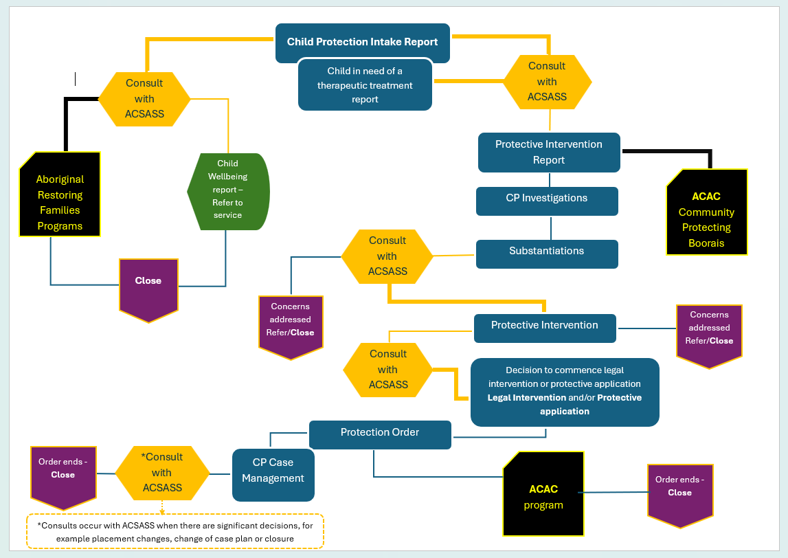
Child Protection Process for Aboriginal children and young people
Aboriginal Child Specialist Advice and Support Service (ACSASS)
ACSASS support Child Protection in decision making for Aboriginal children, providing advice, case consultation and recommendations for connecting children and families to culture, community and Country.
Child protection practitioners are required to consult with ACSASS at the point a report is received regarding an Aboriginal child and regarding all significant case decisions thereafter, across all phases of Child Protection involvement.

Slide 30

When is a child in need of protection?
Section 162 of the CYFA 2005 provides the definition of when a child is in need of protection:
The child has been abandoned by their parents and after reasonable enquiries, the parent(s) cannot be found.
The child’s parents, are dead or incapacitated and no other suitable person can be found​
The child has suffered or is likely to suffer significant​ physical harm, sexual abuse, emotional/psychological harm or neglect AND the child’s parents have not protected or are unlikely to protect the child​
The child is in need of therapeutic treatment for sexually abusive behaviours​
Harm may be constituted by a single act, omission or circumstance or accumulate through a series of continuing acts, omissions or circumstances

Slide 31
Legislation and Protection Orders
Children, Youth and Families Act 2005 (CYFA)
The Act applies to Child Protection, ACAC, Community Based Child and Families Services, Children’s Court and Youth Justice*
*Note: as of September 2026, Youth Justice will come under the Youth Justice Act 2024
Best Interest and decision-making principles guide practice for
The Family Division of the Children’s Court can make these orders if a child is need of protection
Children’s Court (Family Division)
Child Protection and ACAC
Community service organisations
Aboriginal Community Controlled Organisations
Family Preservation Order​
Family Reunification Order ​
Care by Secretary Order ​
Long Term Care Order​
Permanent Care Order
The Family Division of the Children’s Court can also make these types of orders
Undertaking​
Temporary Assessment Order​
Interim Accommodation Order​
Therapeutic Treatment Order
Therapeutic Treatment Placement Order
s.10 For the purpose of this Act the best interest of the child must always be paramount

Slide 32
Helpful guide to identifying child abuse and neglect
Child abuse and Neglect
Sexual abuse
Neglect
Emotional abuse
bruises, burns, sprains, welts, dislocations, bite marks
fractured bones
poisoning
internal injuries
Possible behavioural indicators
showing wariness or distrust of adults
wearing long sleeved clothing on hot days (to hide bruising or other injury
demonstrating fear of parents and of going home
being very passive and compliant
Possible physical indicators
headaches, stomach aches
loss of appetite or weight loss
bed wetting, nightmares or sleep disturbances
bruising on soft parts of the body such as buttocks or thighs
Possible behavioural indicators
child telling someone that sexual abuse has occurred
displaying sexual behaviour or knowledge beyond child's age
poor self-care or personal hygiene
running away
anxiety-related illnesses – such as anorexia or bulimia
Physical Abuse
Possible physical indicators
frequent hunger
poor hygiene
inappropriate clothing – e.g. wearing summer clothing in winter
left unsupervised for long periods of time
medical needs not attended to
Possible behavioural indicators
stealing food
often tired, falling asleep
developmental delays due to lack of stimulation
listless or immobile, emancipated and pale
poor or irregular attendance at a service – e.g. child care or school
Possible physical indicators
There are few physical indicators, although emotional abuse may cause delays in emotional, psychological, or even physical health development
Possible behaviour indicators
displaying low self-esteem
tending to be withdrawn, passive, tearful
displaying aggressive or demanding behaviour
being highly anxious
Possible physical indicators

Slide 33
To Refer (to The Orange Door) Or To Report (to Child Protection)

Slide 34



Refer or Report: Quick Reference Guide
Refer to The Orange Door
Referrals to The Orange Door as a free intake and assessment service when:
Families requiring support for their children or young person’s wellbeing or development
Children, young people or families needing parenting support
Young, isolated, or unsupported families
Individuals and families experiencing family violence
Adults using family violence
Young people using violence in the home.
Report to Child Protection
It is a mandatory report to Child Protection when:
You are a mandated reporter and
You form a belief on responsible grounds that a child is in need of protection from physical injury or sexual abuse
Other circumstances when you should make a report:
You have formed a belief on reasonable grounds that a child is in need of protection
The child's parent/s have not protected or are unlikely to protect the child from this harm
The child is under 17 years old and needs statutory intervention
Severe emotional or psychological abuse is happening
Serious neglect is affecting the child's development or safety
A child is at significant risk of abuse or harm.
You do not need consent to get advice from or refer to The Orange Door network. Where safe, reasonable and appropriate you should discuss your concerns with the family first to assist with the referral, as this is likely to increase willingness to engage with services.

Slide 35
Two distinct but interconnected pathways
The Orange Door
Child Protection Intake
State-wide Child Protection Intake Service and After-Hours Child Protection Service
State-wide entry point for integrated intake and assessment for family violence and child and young person wellbeing concerns (including unborn children)
State-wide entry point for professionals and the public with significant concerns for children and young people’s safety (and unborn children)
PURPOSE
Partner agencies including ACCOs, Family Violence services, Family services, and Community Based Child Protection
WORKFORCE
Child Protection Practitioners (CPPs)
Anyone – professionals, families, public, self
Mandatory reports (s184 CYFA) mandates that specific professionals must report to Child Protection belief that a child (under 17) needs protection from physical or sexual abuse
Anyone – professionals, families, public, self
SOURCE
Families requiring support for their children and young person’s wellbeing and development, including parenting support
Individual and families experiencing family violence, and adults and young people using family violence
A child has suffered or is likely to suffer significant harm as a result of abuse and/or neglect, and their parent has not, or is unlikely to protect them
THRESHOLD
Assess to determine need for services and support and progress to services such as Family Services or Family Violence support services. If required, report to Child Protection
Assess to determine if meets threshold for further investigation and possible statutory intervention (protection). If not close with or without a referral to The Orange Door, a family service or a service agency.
OUTCOME
Voluntary service – consent not required to make a referral; however TOD will need to seek consent to provide services and support
CONSENT
Consent not required to report or investigate

Slide 36
Mandatory Reporting and other Reporting Requirements

Slide 37






Mandatory Reporting Requirements in Victoria
Mandatory reporting (s182 CYFA) is the legal obligation of certain professionals in Victoria to report incidences of child physical injury and sexual abuse where the parent has not protected or is unlikely to protect the child from that harm.
Mandatory Reporters
registered medical practitioners
nurses
midwives
registered teachers and early childhood teachers
school principals
school counsellors
police officers
out of home care workers (exc. voluntary foster and kinship carers)
early childhood workers
youth justice workers
registered psychologists
people in religious ministry
Family Law Act (FLA) s67z
Any other abuse type (e.g. neglect or emotional abuse) are not subject to mandatory reporting obligations, but can still be reported to Child Protection, if you believe the child has suffered, or is likely to suffer significant harm from those abuse types.

Slide 38
When should a mandatory report be made
In Victoria (s184 CYFA) mandated reporters must make a report if:
In the course of practising their profession or carrying out duties of their office, position or employment they form a belief on reasonable grounds that a child is in need of protection from physical injury or sexual abuse.
The report must be made as soon as practicable after forming the belief and after each occasion on which they become aware of any further reasonable grounds for the belief.
In need of protection (in relation to physical or sexual abuse):
the child has suffered or is likely to suffer significant harm AND
their parents have not protected or are unlikely to protect them from harm of that type
Remember, harm can
be a single act, omission or circumstance or accumulate through a series of acts, omissions or circumstances
Belief on reasonable grounds
if a reasonable person doing the same work would have formed the belief on those grounds

Slide 39
Making a Report to Child Protection

Slide 40
When reporting concerns for a child’s safety
When you have concerns for a child’s safety you can report to Child Protection if you have formed reasonable belief
That a child is or may be in need of protection
The child has suffered significant harm or damage to their health or development
Their parents have not protected and are unlikely to protect the child from harm of that type
Statutory child protection intervention may be required to provide for the child’s safety
Example of harm may include:
physical injury, non-accidental or unexplained injury
Sexual abuse
Where a child appears to have been abandoned, or where the child's parents are dead or incapacitated
emotional or psychological
Significant neglect, poor care or lack of appropriate supervision
Significant family violence, persistent parental substance misuse, psychiatric illness where there is a likelihood of significant harm to the child
Other reasons a child may be in need of protection
a child’s actions or behaviour place them at risk sexual abuse
a child exhibiting sexually abusive behaviours and refusing therapeutic treatment
a child appears abandoned, child’s parents are dead or incapacitated, and no other suitable person is willing and able to care for the child
where a child’s actions or behaviour may place them at risk of significant harm and the parents are unwilling or unable to protect the child

Slide 41


Do’s & Don'ts - If a child makes a disclosure about abuse
DO
Listen to the child without interrupting
Give support by demonstrating that you believe them
Avoid emotional reactions and be as professional as possible
Collect essential information – what happened next?
Record what you have been told and advise the child what you will do next
t
Don’t
Express negative suggestions such as judgement, doubt or shock
Make promises you cannot keep - for example not to tell anyone else

Slide 42

Making a Child Protection Report: Handy Tips
Try and have as much of the following information available when making your report:
Identifying information: child’s name, address, DOB, other family members including parents and siblings
A description of the concern: any injuries, the behaviour, observations, what was said
The reason for believing that the injury or behaviour is the result of abuse
Information relevant to any immediate concerns, safety and danger: such as the whereabouts of the person causing the harm
Details about the child’s support network and ecosystem: extended family, school, medical and support services
If you know the child or family are Aboriginal, any cultural information
If you know the child or family are culturally or linguistically diverse, any relevant information: language, support network, cultural needs
Whether the child or family know you are making a report
https://providers.dffh.vic.gov.au/making-report-child-protection

Slide 43
Information Sharing and MARAM Framework

Slide 44
About Information Sharing
Information sharing is a key enabler of collaborative practice and promotes the wellbeing or safety of children, young people and adults. It enables professionals to understand all of the circumstances of the child and family through the appropriate sharing of information.
Services are encouraged to work proactively and collaboratively with each other to improve the wellbeing or safety of common clients or clients and families who need additional support.
There are existing legislative pathways that authorise professionals to share relevant information in certain circumstances such as for Child Protection purposes under the Children, Youth and Families Act 2005.
The Child Information Sharing Scheme (CISS) and the Family Violence Information Sharing Scheme (FVISS) are additional pathways for prescribed Information Sharing Entities (ISEs) to exchange information.

Slide 45
Information Sharing Legislation
Child Protection specific information sharing
Children, Youth and Families Act 2005
Sharing with and by Child Protection
Purpose specific information sharing
Child, Wellbeing and Safety Act 2005
Child Information Sharing Scheme
(CISS)
Family Violence Protection Act 2008
Family Violence Information Sharing Scheme (FVISS)
Youth Justice Act 2024
Coming into effect in September 2026
Any other information sharing
Health Records Act 2021
Privacy and Data Protection Act 2014

Slide 46
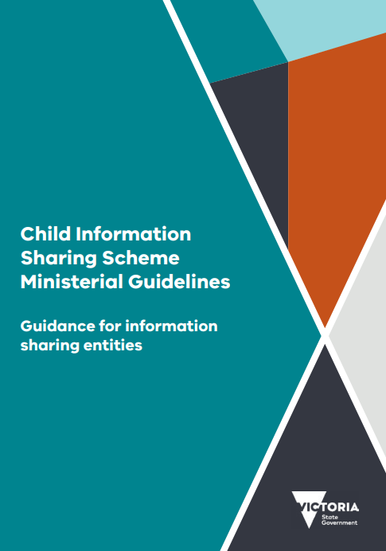
Child Information Sharing Scheme (CISS)
The Child Information Sharing Scheme (CISS), established under Part 6A of the Child, Wellbeing and Safety Act 2005 enables authorised organisations and services to share information to promote the wellbeing or safety of children and facilitate services working together to:
identify needs and risks promote earlier and more effective intervention and integrated service provisions
improve outcomes for children and families.
All Victorian children and young people from 0-18 years of age are covered by the CISS.
For both schemes, while consent is not required from children, practitioners are still encouraged to seek and consider the views of the affected individual/s and consider their safety if information is shared if their consent is not sought.

Slide 47
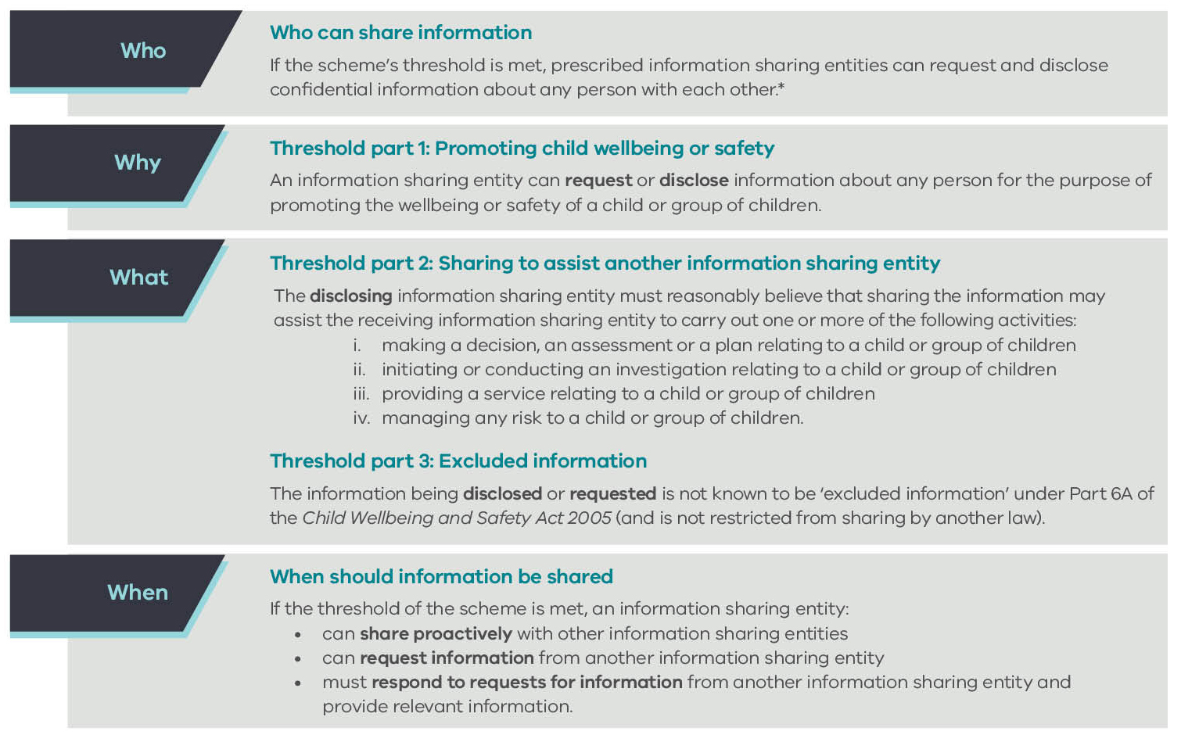
Child Information Sharing Scheme (CISS)
Examples:
A hospital social worker requesting information for birth planning purposes relevant to an 'unborn' child where there were some concerns.
A school with concerns related to a child disclosing information regarding discipline in the home.
A school seeking information regarding assessments to determine whether there is a need for greater support to the family for continued engagement of the child in their education.
An AOD practitioner with concerns regarding a parent’s ongoing substance misuse.

Slide 48
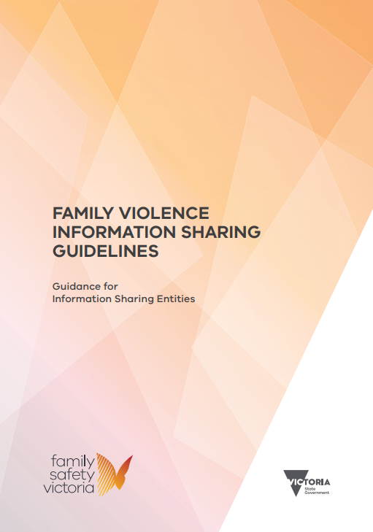
Family Violence Information Sharing Scheme
The Family Violence Information Sharing Scheme (FVISS), established under Part 5A of the Family Violence Protection Act 2008, enables authorised organisations and services to share information to facilitate the assessment and management of family violence risk to children and adults. It also facilitates keeping perpetrators of family violence in view and held accountable for their actions.

Slide 49
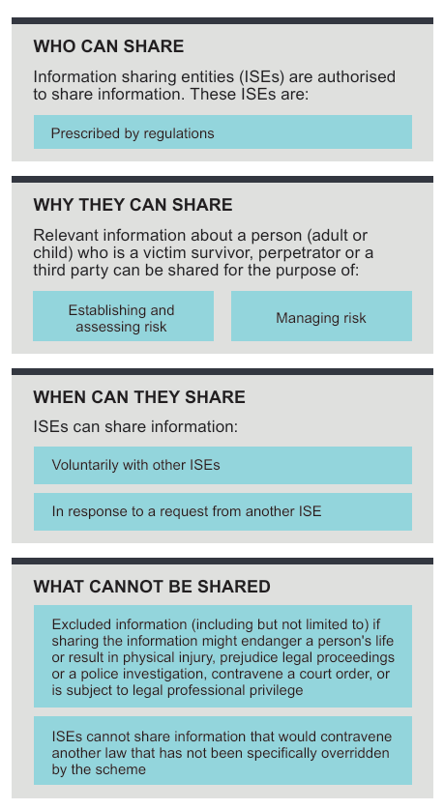
Family Violence Information Sharing Scheme
Examples:
A therapeutic family violence service is seeking information about the person using violence in the home so that can provide the appropriate support to their client.
Victoria Police is seeking information held by Child Protection relevant to an application for an IVO.
A school seeking information regarding a student’s experience of historical family violence to identify appropriate supports
RAE requests information to establish the presence of family violence risk.
Examples of ISE’s include Victoria Police, Family Violence services, Alcohol and Other Drugs (AOD), Hospitals, etc.
Some ISEs are also prescribed as Risk Assessment Entities (RAEs)

Slide 50
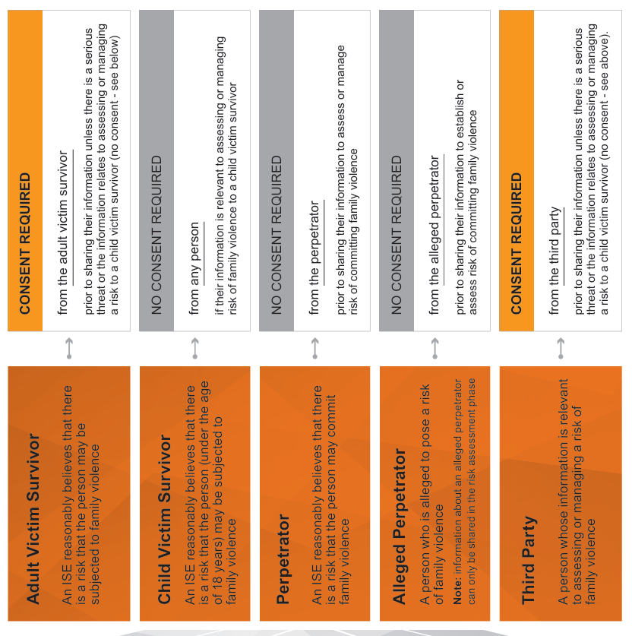
Family Violence Information Sharing Scheme, Consent

Slide 51
Making a CISS or FVISS Request to Child Protection
Otherwise, authorised professionals from an ISE can request Child Protection information under the FVISS or CISS from the department using a secure webform – compliant requests for closed cases will receive a response in writing (usually within 7 business days). Requests for open cases will be referred to the allocated worker for a response. [https://informationsharingteam.powerappsportals.com/FVISSCISS]
If you know there is an open case, you can contact the allocated child protection practitioner and discuss any request with the them directly.
General enquiries can be emailed to info.exchange@dffh.vic.gov.au

Slide 52
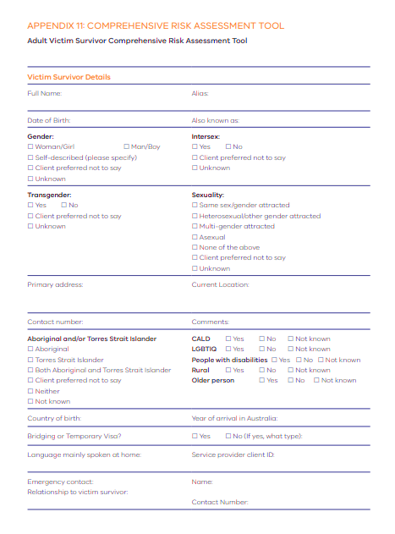
MARAM Framework
The Family Violence Multi-Agency Risk Assessment and Management (MARAM) Framework promotes consistency in language and understanding as well as setting out the responsibilities of different workforces in identifying, assessing and managing family violence risk across the family violence and broader service system​.
The MARAM Framework, established under the Family Violence Protection Act (2008), requires prescribed organisations to align their policies, procedures, practices and tools to MARAM. Schools, The Orange Door and Child Protection are all prescribed organisations.
The MARAM Framework supports prescribed organisations to:
Identify evidence-based risk factors for children, young people and adults and provides guidance for how to do this across diverse communities, identities, family and relationship types
assess and manage family violence risk when working with children, young people and adults experiencing family violence and young people and adults using family violence.
All parts of the service system will have a shared understanding of family violence risk

Slide 53
Child and young person-focused MARAM Practice Guides and tools. For release in 2026
New MARAM resources will be released in 2026 and provide practice guidance for engaging directly with:
children and young people to identify and respond to wellbeing needs
children and young people who experience family violence from a family member
young people who experience family violence in intimate partner, dating or casual relationships
young people using family violence in the home, towards parents, siblings, caregivers, and other family members
young people using family violence in intimate partner, dating or casual relationships.
These new resources are for use across all sectors, and each department and service will take time to implement these.
Notes:
The new resources will provide practice guidance for professionals to engage directly with:
children and young people to identify and respond to wellbeing needs
children and young people who experience family violence from a family member
young people who experience family violence in intimate partner, dating or casual relationships
young people using family violence in the home, towards parents, siblings, caregivers, and other family members
young people using family violence in intimate partner, dating or casual relationships
misidentification occurring in the context of young people – this includes in the context of intimate partner violence as well as where there is an adult using family violence towards the young person.
Key Points
The new resources contain practice guidance for children and young people up to age 25.
The new resources aim to support professionals to identify and assess family violence risk and risks and needs impacting on a child or young person’s wellbeing simultaneously to support early identification and intervention.
The language in the new resources aligns with existing MARAM resources and build on practice concepts you will already be familiar with.
They centre the child or young person, focusing on direct engagement, and aim to enhance system wide capability to use trauma and violence-informed and culturally safe practice frameworks.
The resources provide guidance on applying an age and developmental stage lens to risk assessment for children and young people.
Content on suicide has been developed and is included in recognition of the intersection between family violence and suicide risk for children and young people.
There will be a lot of work across the system to update their responses where they aren’t already doing these practices, which will be led by departments. It is important to know this is coming at this stage, even just from an awareness perspective, not that we are expecting you to do anything right now.

Slide 54
Case Study Examples

Slide 55
Case Examples of Reports to Child Protection
Case study 1
Destiny is 14 years old and has two younger siblings. She has attended school today and appears upset. Destiny approaches her teacher and discloses that:
She does not want to go home after school.
Last night she was late home from a friend's house and her father became angry.
When she tried to explain why she was late, her father refused to listen. He pushed her into the wall and screamed at her.
He always gets angry at Destiny, and her mother is too scared to stop him as she doesn't want to get hit again.
He gets angry with her two younger brothers, and she is worried he will seriously hurt them.
He is really strict and punishes the three children by hitting them with a strap.
Destiny is concerned she will be punished when her father finds out she has spoken to her teacher.
Case study 2
Bailey is 3 years old with developmental delay. He resides in the care of his parents in Office of Housing accommodation.
A housing worker attends the family home and observes:
The house is extremely cluttered and there is an unpleasant odour. There are dirty dishes in the kitchen and loungeroom, and food scraps on the furniture and floor.
Bailey's room is sparsely furnished with a set of drawers and a porta-cot, which the parents explain is where he sleeps. The bedding is unkempt and there is a distinct smell of urine.
Bailey is small and looks underweight. He cannot walk, is non-verbal and appears to have a linier bruises on his arm and leg
The parents advise that Bailey is not attending childcare and hasn't seen his paediatrician for about 12 months. They don't seem concerned about this.

Slide 56
Case Examples of Referrals to The Orange Door
Case study 1
Frankie is a 1-year-old. They live with their father, following the death of their mother during childbirth. The father has attended the MCHN for the 1-year-old check-up and the MCHN observes:
The father is struggling to juggle work, appointments for Frankie and grieve the loss of his wife.
The father has limited family supports locally to assist with the care of Frankie.
Frankie is currently on a waitlist to access child-care, but the father needs to return to work full time soon to continue to provide financially for Frankie.
The father presents as having a strong attachment to Frankie, however; is very overwhelmed.
There are no other concerns identified for Frankie who is meeting the expected milestones.
Case study 2
Helen, a teacher at Smith Street Primary School has concerns for her student, Mikey (11 years old), after he disclosed his father, Philip is ‘always angry’ towards his mother, Glenda, and has been hitting her. Mikey’s parents were previously separated and have recently reconciled.
Helen has also observed Mikey has had increased absences or arriving to school late this term, and there have been changes in his engagement with schoolwork.
Helen met with Glenda when she came to collect Mickey from school. Glenda disclosed that Philip has been physically and verbally abusive towards her and this has been increasing since he lost his job last month.
Glenda also disclosed her concerns about Philip monitoring her phone and whereabouts.
Glenda consented to Helen contacting The Orange Door for support.

Slide 57
Case Examples of Secondary Consults with The Orange Door
Case study 1
Jamie is 7 years old. She lives with her grandmother and older half-sibling aged 14 who has an Intellectual Disability.
The classroom teacher and school wellbeing advisor has started to observe:
Jamie is starting to miss school more regularly with unexplained absences.
When Jamie does come to school, she doesn’t want to participate in classroom activities and appears disengaged and tired.
Jamie had 1 good friend at school who has moved interstate. The teacher has noticed Jamie’s peers have tried to include her in play, however Jamie withdraws and will often be seen sitting on their own.
The teacher suspects that Jamie is highly anxious but won't really speak about her feelings.
The school wellbeing advisor and teacher have spoken with Jamie's grandmother who expressed feeling overwhelmed and indicated she may be interested in further community supports.
Case study 2
Sally is year 8 student with diagnosed autism. She lives at home with her Mother and Father and two younger siblings.
The classroom teacher has observed:
several interactions with Jamie and her Mother where Jamie flinches when her Mother touches her.
The teacher is concerned but is worried that she may be misreading the signs.
The teacher follows her 4CA guidance and completes a FV identification tool and gives this to the MARAM responsible staff member at her school. This is vice principal.
The vice principal looks over this tool and is still unsure so calls The Orange Door.

Slide 58
Professional Reporter and Referrer Information Hub

Slide 59
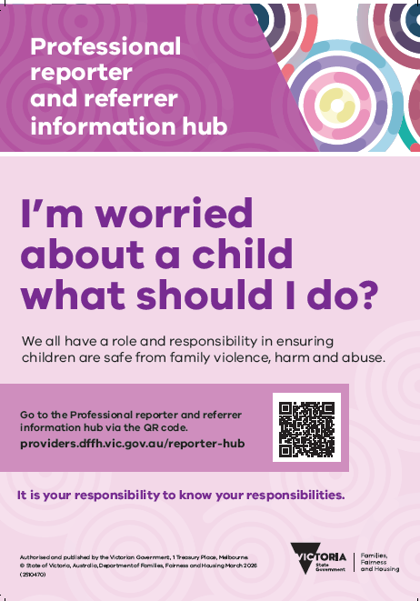
Professional Reporter and Referrer Information Hub
In December 2025, the Professional Reporter and Referrer Information Hub became available for those who are concerned about the safety and wellbeing of a child or young person.
The new information hub will:
ensure professionals have access to clear guidance and information before making a report to child protection or referral to The Orange Door
streamline reporting and referral processes
improve children and families’ participation with child protection, The Orange Door and family services.
The information hub is designed to help ensure the system is working efficiently and that children and families are getting the right support at the right time.
The information hub is available to anyone making a report, including mandatory reporters and referrers. We all have a role and responsibility in ensuring children and young people are safe from family violence, harm and abuse.
Visit the Professional reporter and referrer information hub webpage.

Slide 60
Appendices
Mandatory reporting and other legislative requirements
Resource links

Slide 61

Mandated Reporters: Out of Home Care
An out of home care worker means a person employed (other than on a voluntary basis) by an out of home care service:
as a carer for children
as a provider of services to carers for children or the children in their care
Out of home care worker includes:
foster care workers
kinship care workers
residential care workers
secure welfare service workers
adoption and permanent care workers
labour hire staff working in out of home care settings
workers supporting children in voluntary childcare arrangements
lead tenant workers
supervisors and managers of the above
targeted care package key workers
disability residential care workers
It does not include volunteer carers of children in foster or kinship care arrangements, lead tenant, adoption and permanent care.

Slide 62

Mandated Reporters: Youth Justice
Youth justice workers that are mandated reporters include; youth justice officer, youth parole officer and youth justice custodial workers
Youth Justice workers who are mandated reporters include:
A youth justice custodial worker employed or engaged in a remand centre, a youth residential centre or a youth justice centre, and whose duties include duties in relation to detainees in the custody of the Secretary
A youth justice officer includes the Secretary, and every honorary youth justice officer
A youth parole officer includes an honorary youth parole officer

Slide 63

Mandated Reporters: Education and Early Childhood
All educators with post-secondary qualifications in the care, education or minding of children and employed or engaged in an education and care service or a children’s service
The proprietor or nominee (including the primary nominee) of a children’s service, or the approved provider or nominated supervisor of an education and care service
Education and early childhood work locations include:
children’s services
schools, teachers and principles
occasional care
sports and leisure services
education and care services
long day care
family day care
outside school hours care
vacation care
kindergartens
pre-schools
The Department of Education has refreshed their PROTECT guidance
PROTECT supports schools to identify and respond to child abuse.
The refreshed PROTECT guidance now reflects the current family and specialist service system. It provides clearer advice on when to support, refer and when to report.
New 4 Critical Actions - IDENTIFY, SUPPORT, REFER and REPORT.

Slide 64

Mandated Reporters: Health and other professionals
A registered psychologist is a person registered (including those provisionally registered) under the Health Practitioner Regulation National Law to practice in the psychology profession (other than as a student, unless the student is a registered psychologist).
A school counsellor means a person employed or engaged (other than on a voluntary basis) to provide direct support to school students, at or directly connected with a school, for mental, emotional or psychological wellbeing.
Health practitioners include:
Doctors
Nurses
Registered teachers
Registered psychologists
Speech pathologists
Chaplains (including religious ministers

Slide 65
Reporting Requirements
 | Who must report | What must be reported | Report to | Age of child
Mandatory reporting | Mandatory reporters s.182 CYFA 2005 | Child physical injury and sexual abuse, actual or likely, parents have not protected or are unlikely to protect | Child Protection | Under 17
Reportable conduct | Head of an organisation Child Wellbeing and Safety Act 2005 | Child abuse and neglect by a worker or volunteer | Commission for Children and Young People | Under 18
Failure to protect | Head of an organisation Crimes Act 1958 Sec 490 | Risk of sexual abuse by adult associated with the organisation | Police | Under 18
Failure to disclose | All adults Crimes Amendment (Protection of Children) Act 2014 | Child sexual abuse by an adult | Police | Under 16

Slide 66
What is a failure to protect?
Relevant organisations include but are not limited to:
churches
religious bodies
education and care services (e.g. childcare centres, family day care, kindergartens and outside school hours care)
licensed children's services such as occasional care services
schools and other educational institutions
organisations providing accommodation to children and young people, such as boarding schools and student hostels
out-of-home care services
community service organisations providing services for children
hospitals and other health services
government agencies or departments providing services for children
municipal councils (for example those that deliver Maternal and Child Health services)
sporting groups
youth organisations
charities and benevolent organisations providing services for children
A criminal offence for failing to protect a child under the age of 16 from the risk of sexual abuse.
Applies to people within organisations:
if they hold a position of authority
within a relevant organisation that works with children
they know of a substantial risk another adult associated with the organisation may commit a sex offence against a child under 16 within the organisation’s care
they have the power or responsibility to remove or reduce that risk
but they negligently fail to do so

Slide 67

What is a failure to disclose?
Failure to disclose child sexual abuse is a criminal offence.
The law states that all adults must report to police when there is:
any reasonable belief that a sexual offence has been committed, by another adult (over 18) against a child under the age of 16
unless there is a reasonable excuse, or an exemption applies
The simple rule
If you have a reasonable belief that a sexual offence has been committed by an adult against a child in Victoria, you must report that belief to Victoria Police.
Failure to disclose does not replace mandatory reporting obligations

Slide 68
Resources and Links
Child Protection | The Orange Door | Information Sharing/MARAM
Identifying abuse Identify signs of child abuse | Victorian Government Professional Reporter and Referrer Information Hub https://providers.dffh.vic.gov.au/reporter-hub Reporting abuse https://services.dffh.vic.gov.au/reporting-child-abuse https://providers.dffh.vic.gov.au/making-report-child-protection Mandatory reporting https://providers.dffh.vic.gov.au/mandatory-reporting The Child Protection Manual www.cpmanual.vic.gov.au | The Orange Door Website https://www.orangedoor.vic.gov.au/ Professional Reporter and Referrer Information Hub https://providers.dffh.vic.gov.au/reporter-hub Support available Support for families | orangedoor.vic.gov.au Support for when you feel unsafe | orangedoor.vic.gov.au Support for children and young people | orangedoor.vic.gov.au Support for people of Aboriginal or Torres Strait Islander descent | orangedoor.vic.gov.au Support for people using family violence who want to change their behaviour | orangedoor.vic.gov.au | Family Violence Family Violence Information Sharing Scheme | Victorian Government (www.vic.gov.au) https://www.vic.gov.au/family-violence-information-sharing-scheme MARAM Practice Guidance https://www.vic.gov.au/maram-practice-guides-and-resources MARAM and Information Sharing Training https://www.vic.gov.au/training-for-information-sharing-and-maram

