Slide 1


Supervision within Child Protection
Child Protection Policy Unit

Slide 2
Learning Objectives
    To provide information and practice advice to child protection practitioners in the area of supervision to promote staff wellbeing, good practice and good quality service provision
    To highlight and emphasise the organisational requirements of supervision and supervisor responsibilities
    To reinforce departmental key messaging and best practice in relation to supervision
    To reinforce the role of supervision in supporting practice within the SAFER children framework

Slide 3
Child Protection Capability Framework 2012
CRITICAL REFLECTION
ENGAGING OTHERS
MANAGING ONESELF
DELIVERING RESULTS
LEADING AND INSPIRING
Notes:
The Capability Framework describes the capabilities, knowledge and skills required of practitioners and managers (CPP 3 – 6). It describes the building blocks of what is expected from practitioners to effectively do their jobs and deliver the outcomes required. As a manager, the framework assists you with:
defining the capabilities, knowledge and skills required of your staff in each classification
more effectively targeting the development needs of your staff throughout the year and particularly during their performance development discussions
identifying and managing performance issues
identifying capability gaps within your team
strengthening engagement of staff with their roles and thus improve retention
succession planning by identifying people that demonstrate potential.
Critical reflection - Thinking clearly about the decisions we make and the actions that follow is vital. The quality of our thinking will determine the quality of our delivery. Using self-awareness and several analytical techniques to solve complex problems.
Engaging others involves working professionally and effectively with others (children, families, carers, community, service providers and colleagues), listening deeply and building positive and purposeful relationships that help deliver the best outcomes possible.
Managing oneself involves becoming aware of our own thoughts and feelings and how these may impact on others and decision making. It also includes having an awareness of the personal impacts of working in a stressful and traumatic environment, building resilience and being open to new ideas in order to achieve the best outcomes possible.
Consistently delivering results involves working in a highly effective and innovative way that that focuses on the best interests of the child and on achieving positive outcomes for children and families now and for the future.
Effectively leading and inspiring our people helps them to focus on what really matters, and strengthens their professional ability to deliver the best possible outcomes for each child.

Slide 4

The purpose of Supervision
    The purpose of supervision is to give the supervisor and staff member an opportunity to jointly undertake a formal assessment of:
    client needs and undertake planning to address these needs
    the staff member’s professional support needs
    the staff member’s workload, and
    identify practice requirements associated with case management
Notes:
The purpose of supervision is to give the supervisor and staff member an opportunity to jointly undertake a formal assessment of:
client needs,
the staff member’s professional support needs,
the staff member’s workload, and
the administration task involved in Child Protection work.
Child Protection Supervision Standards, June 2005

Slide 5
Supervision Functions
    Managerial
      Competent, accountable performance / practice
    Developmental
      Continuing professional development
    Supportive
      Safe context to talk
    Mediative
      Between all stakeholders
    Tony Morrison 2005
Notes:
These functions of supervision are of course complimentary to the department’s purpose of supervision.
These functions frequently overlap and some may be more dominant at different times, for example dependent of the practitioners stage of development / capability.
1.Managerial.
To ensure professional, accountable Child Protection practice and monitor workloads
2. Developmental / educative function.
The objective is to promote professional competence through the establishment of a collaborative and reflective approach for learning and a focus on continuing professional development / provision of regular performance feedback pursuant to a development plan - Progression, Performance and Development process (PPD).
3. Supportive.
To create adequate workplace safety for practitioners to discuss rewards, challenges, uncertainties and the emotional impact of the work. To monitor supervisee’s safety and wellbeing.
4. Mediative.
To mediate between practitioners, the department and others.

Slide 6

Principles of supervision
The best interests of the child must be at the centre
of supervision
The paramount consideration in supervision is quality service delivery and client outcomes
Notes:
The Best Interests of the child must be at the centre of supervision – the SAFER children framework is at the foundation of all that we do.
The paramount consideration in supervision is quality service delivery and client outcomes.

Slide 7
Principles of supervision cont….
Supervision is scheduled and occurs on a regular basis
There is an interdependence of accountability, professional development and support in supervision
Supervision aims to maximise the practitioner’s performance and provide tailored developmental opportunities, based on adult learning principles
Supervision is based on a negotiated agreement
Supervision aims to provide the foundation for supportive and positive relationships
Supervision is a shared responsibility
Notes:
Supervision is scheduled and occurs on a regular basis – we will take a look at what the policy determines as regular
There is an interdependence of accountability, professional development and support in supervision.
Supervision aims to maximise the practitioner’s performance and provide tailored developmental opportunities, based on adult learning principles.
Supervision is based on a negotiated agreement.
Supervision aims to provide the foundation for a supportive and positive relationships - getting the best outcomes from supervisor to staff, then staff to child/family
Supervision is a shared responsibility.

Slide 8

Principles of supervision cont….
Staff at all levels have the right to high quality, professional supervision.

Slide 9

Trust is at the centre of effective supervision
Practitioners:
require clarity about roles, responsibilities and accountabilities
require support to manage the demands (tasks and emotions) of the work
require a supportive and positive climate that optimises practice and performance, and
must ensure the best interests of the child remain paramount
Munson, 2002
Notes:
Effective supervision cannot occur in a climate of mistrust.
For supervision to be effective staff:
must be clear about roles, responsibilities and accountabilities
must be supported to manage the demands (tasks and emotions) of the work
should be provided with a supportive and positive climate for practice and performance, and
must ensure the best interests of the child remain paramount

Slide 10
Relationships
“Relationships are central to good practice – relationships that engage people in change, build on strengths and creatively look for solutions in partnership with families, and that are characterised by respectful communication and wise use of authority.”
(Source: Miller, R 2009, ‘Engagement with families involved in the statutory system’, in J. Maidment & R. Egan (Eds), Practice Skills in Social Work and Welfare: More than just common sense, 2nd Edition, Allen & Unwin Sydney.)
Notes:
We just mentioned that TRUST is at the Centre of Effective Supervision. TRUST is also at the core of any good relationship, supported and engaged practitioners will in turn support and engage clients; relationships are central to good practice and successful outcomes.

Slide 11
Supervision requirements
Child protection work is unpredictable, and all staff may need unscheduled supervision to address immediate issues. Some aspects of supervision can also be provided as live supervision or in a group supervision context.
However, effective supervision must also include regular scheduled
one-on-one private supervision. The minimum requirements for each role are as follows, and compliance with these minimum requirements is reported on each month.
Classification | Requirement (at least:
Case Support Workers (CPP2) | one (1) hour of scheduled supervision per fortnight
Child Protection Practitioners (CPP 3) | two (2) hours of scheduled supervision per fortnight
Child Protection Practitioners, Team Managers (CPP 4 - CPP 5) | one (1) hour of scheduled supervision per fortnight.
Court Officers, Principal Practitioners (CPP 5, CPP 6) | one (1) hour of scheduled supervision every four weeks
Deputy Area Operations Managers (CPP 6) | one (1) hour of scheduled supervision every four weeks

Slide 12

Supervision can also include:
additional scheduled supervision
unscheduled supervision
group supervision
live supervision
Such supervision is not restricted to
that provided by the direct supervisor
and may include meeting with a
Practice Leader, Senior Practitioner etc
Notes:
Scheduled supervision: regular, planned, one-to-one, uninterrupted and held in a private setting between the supervisor and supervisee. People management tasks such as planning and allocating work and managing and recognising performance occurs. Casework discussion and planning occurs.
Unscheduled supervision: includes consultations on case decision-making, delegation, staff and caseload management, professional development, meeting support needs, service and resource allocation and policy clarification. The nature of child protection practice means many complex issues are discussed in a supervisory relationship as they arise because their resolution cannot wait until scheduled supervision sessions.
Group supervision: structured sessions to address one or more of the supervision functions. This includes reflective practice sessions facilitated by practice leaders or principal practitioners. Team meetings do not automatically constitute group supervision, but they can be used in part, or in full, as group supervision if adequately planned and if this intention is known to team members.
Live supervision: direct supervision of case practice provided by a more senior practitioner observing the supervisee in practice or accompanying the supervisee while engaging with children, families or other professionals. This may include the more senior practitioner role-modelling, mentoring, coaching and promoting self-reflection.
Live supervision is an essential component of supervision.

Slide 13

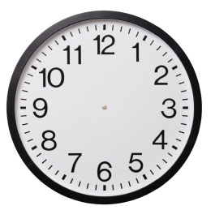
Types of supervision
Scheduled
              Regular
              Planned
              One-to-one
              Uninterrupted
Unscheduled
  Case consultations
  Risk assessment discussions
  Meeting support needs
  Resource allocation

Slide 14

Types of supervision
Group
    intention known
      structured
        reflective
Live
  observation
  support
  mentoring

Slide 15

Workload Monitoring
Case allocation considerations:
Factors relating to the case including the risk assessment and/or review risk assessment
Factors relating to the practitioner
What are these factors?
Victorian Child Protection does not support caseload ceiling or quotas, believing that workloads are subject to professional judgement of relevant factors.
Notes:
Possible Activity:
Break group into half and ask one half to identify factors relating to the case
Other halt to determine factors relating to the practitioner
After 5-10 mins feedback to the group
Factors relating to the case include:
• the seriousness and complexity of the protective issues
• the availability of other organisations to work with the child and family to address the protective issues
• the phase of statutory involvement
• the family’s recognition of and response to protective concerns
• worker safety issues
• whether complaints about case management have been made to the Ombudsman or the Minister
• the level of court-ordered access or supervised access
• whether the case is contracted to a community service organisation.
Factors relating to the practitioner include:
• the practitioner’s level of experience and competence
• the practitioner’s number of current cases and the nature and complexity of the issues within each of the cases allocated to them
• the range of other non-casework duties the practitioner is engaged in
Factors to consider when allocating a particular case to a practitioner:
• recent stressful experiences in managing cases
• recent similar cases
• time-in-lieu and overtime accrual and use
• family and personal issues
• the practitioner’s current functioning
• the practitioner’s training requirements and experiences
• the practitioner’s developmental stage as a Child Protection practitioner

Slide 16

Workload Monitoring
Case allocation considerations:
Practitioner competency
Workload capacity
Workload complexity
Personal circumstances
Case allocation is conducted in the context of
supervision and in consideration of these factors
Notes:
Broadly speaking the factors will fall into one or more of these four categories.
In terms of case allocation - There are no case load controls, allocation is in the context of supervision and in consideration of the factors just mentioned.
As Supervisors you are not authorised to place a sealing on case allocation.
Connelly and Harms (2009) refer to the relationship between the personal-self and professional-self as a central dynamic that needs to be discussed. They discuss the challenge that ‘when workplace tensions rise teams frequently become less cooperative, less communicative and less professionally and personally supportive’.

Slide 17
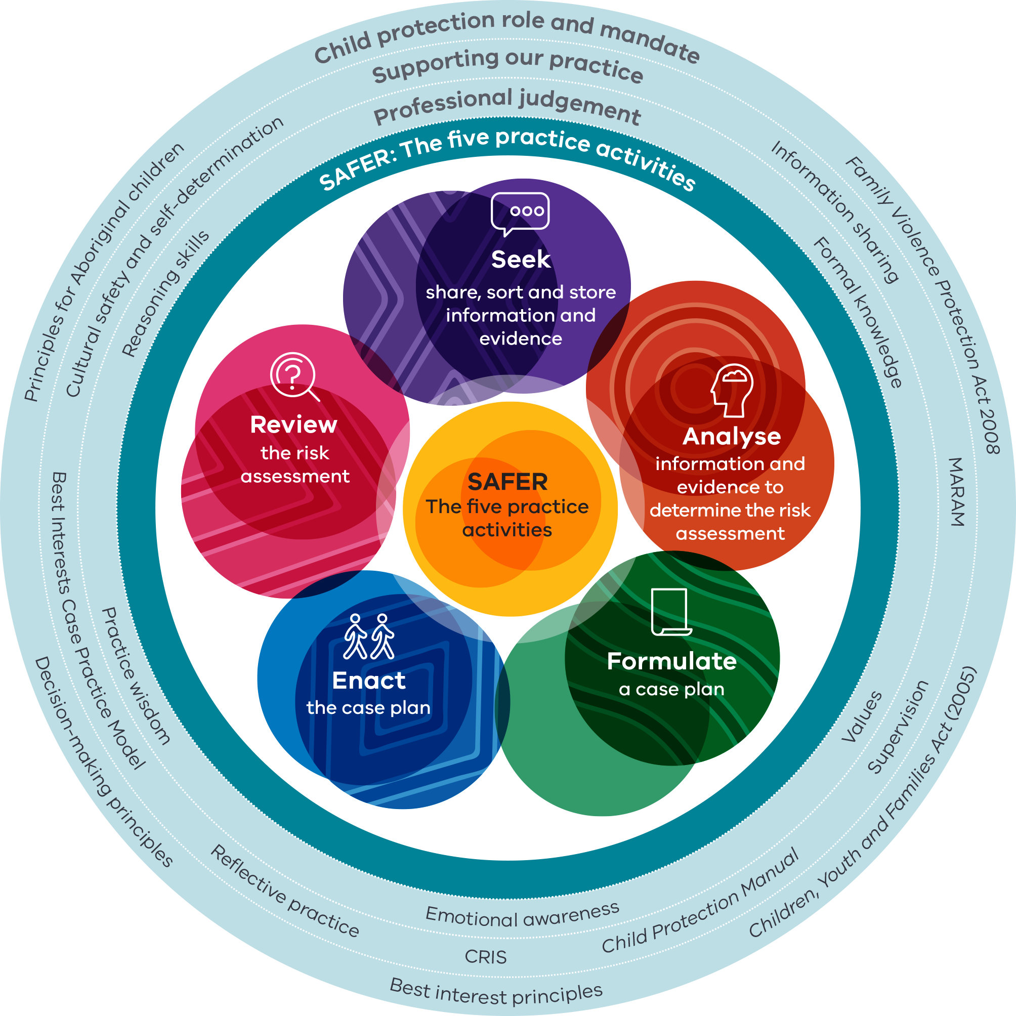
SAFER children framework
The SAFER children framework is a guided professional judgement model.
The five practice activities of risk assessment are at the heart of the SAFER model.
Supervision provides the opportunity to explore child protection practice within the layers of the SAFER framework including role and mandate, consideration of best interests principles and principles for working with Aboriginal children and their families.
Guidance is provided in the SAFER children framework guide and via advice, policies and procedures on the Child Protection manual.

Slide 18
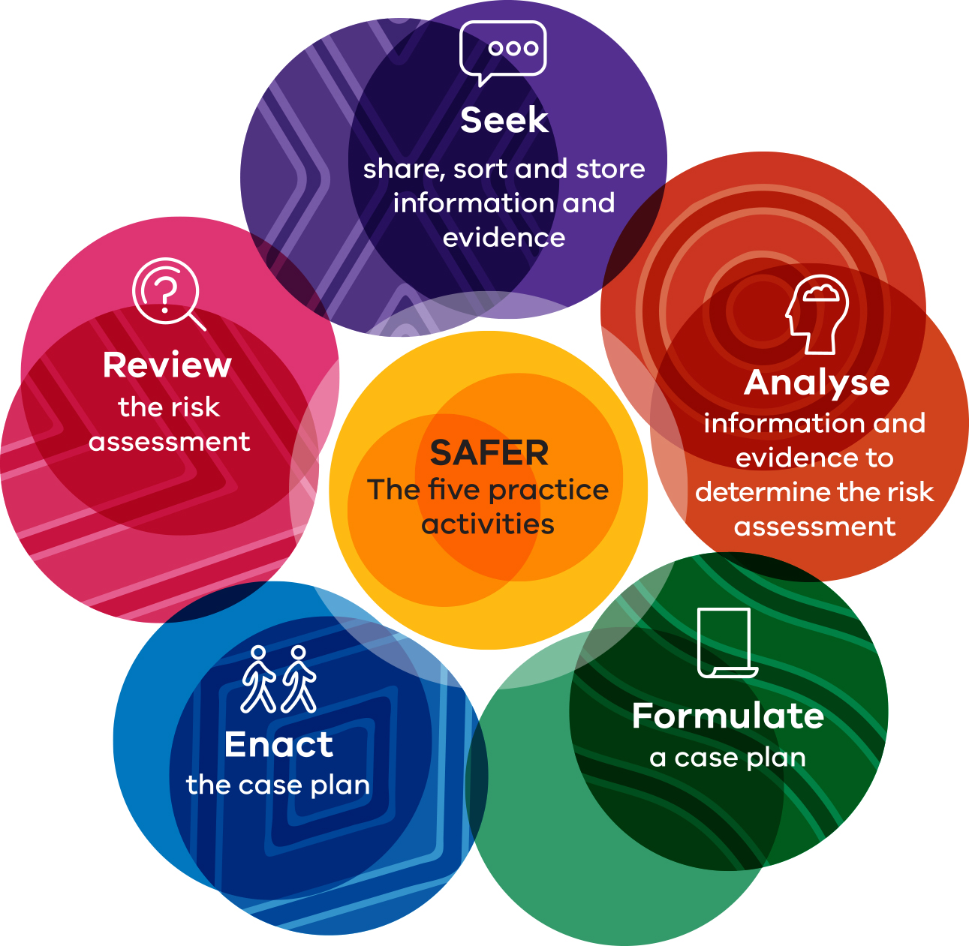
Five practice activities of risk assessment
Risk assessment and case planning discussions in supervision, are guided by the five practice activities of risk assessment in the SAFER framework.
Practitioners and managers have a common language and approach to discuss the seeking and analysing of information in order to make decisions and act on the decisions made.

Slide 19
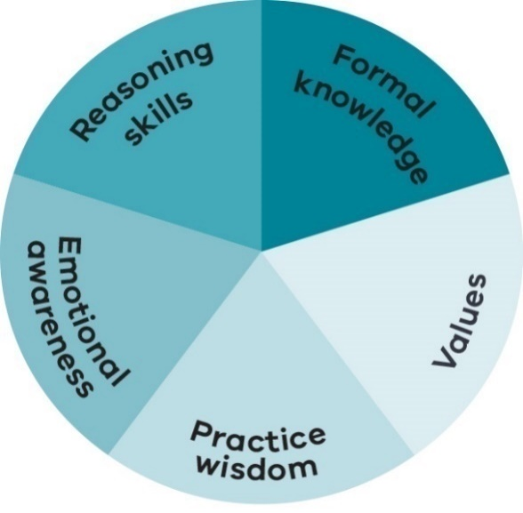
Professional judgement
Child protection is technically challenging at times raw and emotionally taxing work. Practitioners, leaders and managers benefit from supervision.
Supervision provides space to reflect on the five components of professional judgement by building skills and knowledge, exploring values, developing practice wisdom and examining emotional awareness whilst honing analytical and reasoning skills.
Supervision creates a positive flow-on effect to improved outcomes for vulnerable children and families.

Slide 20
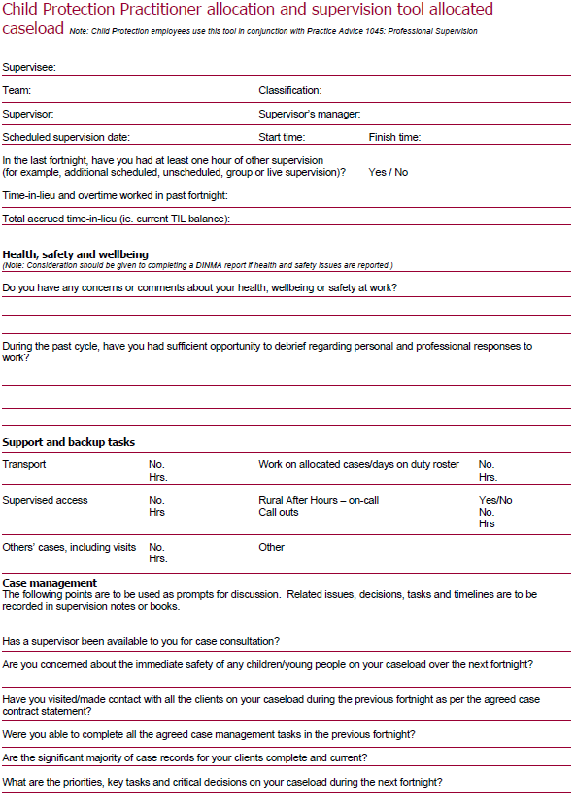
Supervision tools
Supervision sessions must include:
Respectful and open communication
Utilisation of supervision tools to be retained on supervision file
and supervision notes
Discussion and monitoring of concerns
Monitoring of time-in-lieu / overtime
    Overtime will be purposeful, directed and approved
    Time-in-lieu and leave is to be actively managed to ensure work/life balance and safe health and well being
Notes:
Supervision sessions must include:
Respectful and open communication – two way communication for the session to be truly effective.
Clarify standards and expectations
What is negotiable and non – negotiable?
What are your respective roles and responsibilities?
What are the boundaries around, and limits to, confidentiality
Be explicit about record keeping
Prompts:
How will we give each other feedback?
Previous supervisory experiences, and their effects on the way each perceives and approaches supervision
How the supervisee is best motivated and managed in light of his / her previous experiences of supervision and management
Expectations around the handling of authority and conflict within supervision eg and incl. Differences of gender and race within the supervisory relationship
The learning styles of the supervisee and the degree to which this does / does not match the supervisors
Values and attitudes around the significance of difference and inequalities resulting from race, gender, sexuality etc.
Utilisation of supervision tools to document discussions focusing on practitioner caseload and consideration of the factors relating to each case, including the alteration of these factors which may impact on the overall workload of the practitioner
Discussion and monitoring of the concerns and support that might impact of the staff member’s capacity from time to time
Monitoring of time-in-lieu / overtime
Overtime must be purposeful, directed and approved.
TIL and leave managed aggressively to ensure that balances are reduced and controlled to ensure work/life balance and safe health and well being
Consider smart management of staff work hours – productive start times – not sitting having breakfast at desk.
Example of one tool provided

Slide 21
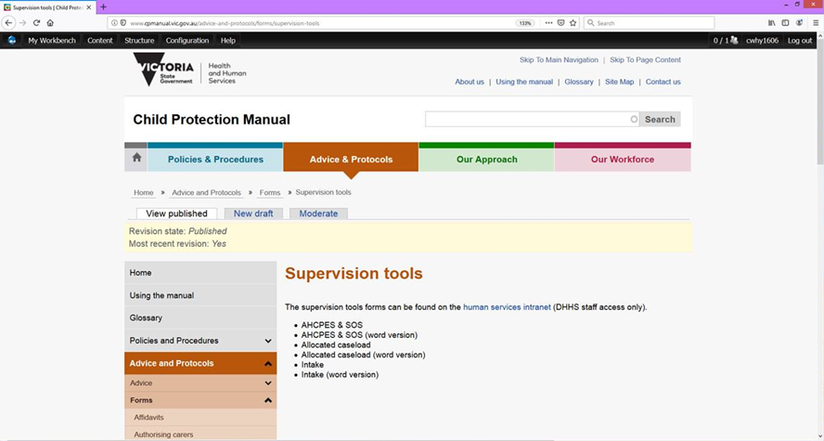
Supervision tools
Notes:
The allocation and supervision tools are located in a secure area in the Child Protection Manual in order that only staff can access them.
To access them all just log on using computer username and password.

Slide 22
“A well negotiated supervision agreement provides the foundation for a robust, focused and safe process within which risks may be taken, innovations attempted, challenges raised and development enhanced”.
Morrison, 2005
Notes:
Ask the question of the group who has an agreement themselves and who has them in place with their staff???
Encourage anyone in the room who has or who has previously had a supervision agreement to discuss how they successfully developed agreements themselves / with staff. Discuss what the content of the agreement was and how it was negotiated. Also explore how this assisted with discussions around workload or any other issues causing concern.
If no one in the room refers to having had an agreement move to next slide!

