Slide 1
Connected Working
with Office 365
Encrypted Emails
How to send encrypted emails in Outlook

Slide 2
Encrypted Emails in Outlook
Encrypting Emails in Outlook
Encrypting emails in Outlook is a great way to minimise risk of unauthorised access to information you wish to share. Encryption works by scrambling the plain text in an email. Only specified users have access to read the information will be able to see the unscrambled original version of the email.
Encrypted emails in Outlook can be sent to other non-Microsoft email services (e.g. Gmail or Notes).
There are two options to protect your information in Outlook: Encrypt Only and Do Not Forward.
Attachments in encrypted emails
Some files attached to encrypted emails, such as Microsoft Office documents (Word docx, Excel.xlsx, PowerPoint.pptx), also inherit security restrictions from the encrypted email.
This means that attached Microsoft file format documents will have rights protection applied to restrict permissions. The type of protection applied to the documents is dependant on the type of encrypted email it was sent. See pg.5 on file permissions for more information.
Microsoft Office compatibility
Documents with rights management attached, such as files sent through Outlook encrypted emails, can only be opened with Microsoft Office products released from 2010 onwards.
Recipients accessing these files using older versions of Microsoft Office products can do so via Microsoft Online (e.g. Word Online, Excel Online, PowerPoint Online).
Encrypt Only
As the name suggests, Encrypt Only emails provide only email encryption. This helps minimise the risk of your information reaching unauthorised users.
Do Not Forward
The Do Not Forward option both encrypts emails and prevents recipients from forwarding the information shared by disabling the ability to Copy, Print & Forward.
Pro tip: Email encryption is great for use when you want to encrypt your email message. Should you wish to protect documents that require collaboration, consider using SharePoint or Microsoft Teams.

Slide 3
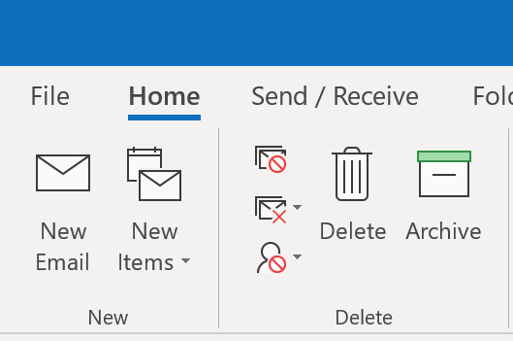
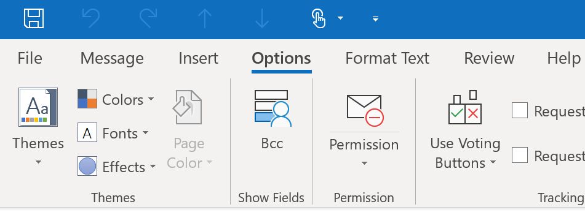
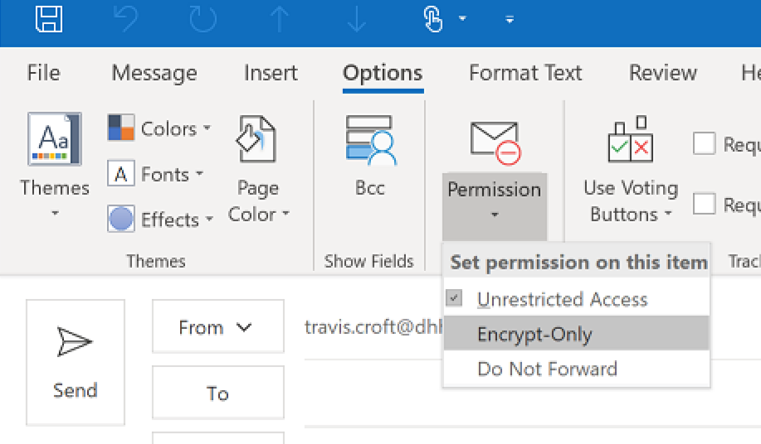
How to send an encrypted email
How to send an encrypted email in the Outlook app
Follow the instructions below for protecting emails in the Outlook app. For instructions on how to do this using Outlook Web App, see pg.4
Choose New Email
Choose the Options tab and select the Permission arrow. Note: Clicking the Permission icon automatically adds “Do Not Forward” encryption to the email. This can be changed by clicking the Permissions arrow and selecting the appropriate encryption type.
Select the type of encrypted email you wish to send (Encrypt Only or Do Not Forward).
A banner will appear on the draft email. The contents of the banner will depend on the type of encrypted email you selected.
Finish writing your email and send when ready
Adding attachments to encrypted emails
Some files attached to encrypted emails, such as Microsoft Office documents (Word docx, Excel.xlsx, PowerPoint.pptx), also inherit security restrictions from the encrypted email.
This means that attached Microsoft file format documents will have rights protection applied to restrict permissions. The type of protection applied to the documents is dependant on the type of encrypted email it was sent. See pg.5 on file permissions for more information.
1
2
3
4

Slide 4
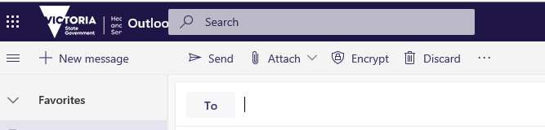
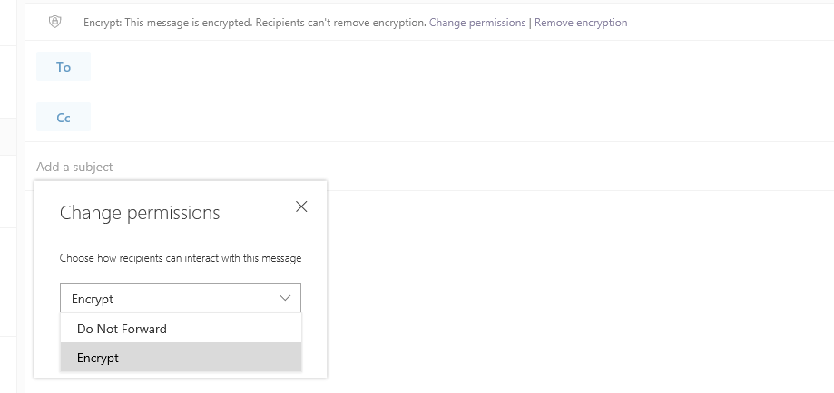
How to send an encrypted email
How to send an encrypted email in the Outlook Web App
Choose New Email
Select Encrypt in the draft email. Note: by default, Encrypt Only is selected
Choose Change Permissions if you would like to change the encryption type and select the type of protection you would like applied (Encrypt Only or Do Not Forward).
A banner will appear on the draft email. The contents of the banner will depend on the type of encrypted email you selected
Finish writing your email and send when ready
Adding attachments to encrypted emails
Some files attached to encrypted emails, such as Microsoft Office documents (Word docx, Excel.xlsx, PowerPoint.pptx), also inherit security restrictions from the encrypted email.
This means that attached Microsoft file format documents will have rights protection applied to restrict permissions. The type of protection applied to the documents is dependant on the type of encrypted email it was sent. See pg.5 on file permissions for more information.
1
2
3
4
5

Slide 5
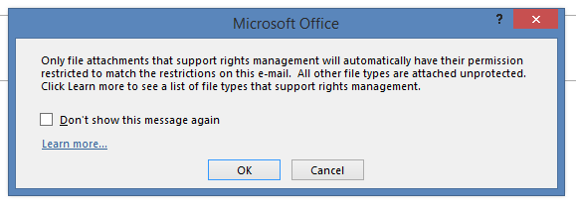
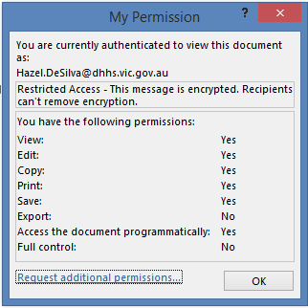
Encrypted Email Attachments
Attached Microsoft File Formats
When Microsoft Office documents, such as Word.docx, Excel.xlsx, PowerPoint.pptx, are attached to an encrypted email they will inherit rights protection. Protection to the document is dependant on the type of encrypted email it was sent through.
Documents with rights protection added have limited functions available to recipients receiving the file.
Sending Attachments in Encrypted Emails
Prior to sending the encrypted email with attachments, a prompt will appear stating that only compatible Microsoft File formats will inherit rights protection.
Choose OK to send the file and attachments, OR
Check the box stating “Don’t show this message again” prior to selecting OK
Encrypt Only Email Attachments
Attachments sent through Encrypt Only emails have Export permissions removed.
Do Not Forward Email Attachments
Attachments sent through Do Not Forward emails have Print, Copy & Forward permissions removed.
2
1
To view your permissions to a document, refer to pg.9
Pro tip: Attachments where collaboration is required; save the file into a SharePoint folder with the appropriate restrictions and send a document link in the encrypted email.

Slide 6
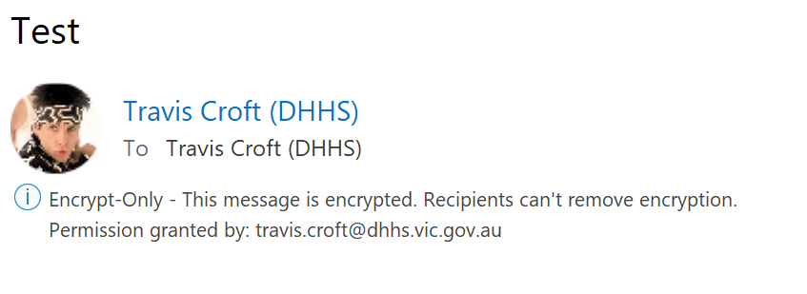
Receiving Encrypted Emails
What to expect when you receiving an encrypted email in Outlook
An alert symbol will appear in the email summary in the mail pane
An information banner will appear in the email stating what type of encrypted email was sent, as well as the person who granted permissions to the email and its attachments
When you open the email there will be a banner underneath the sender's name stating the type of encrypted email.
Receiving a Do Not Forward email in Microsoft Outlook
Do Not Forward emails have the Forward function disabled.
Should you wish to Reply or Reply All to a Do Not Forward email, you will be unable to add/remove any recipients to the To, CC or BCC fields.
1
2
3

Slide 7
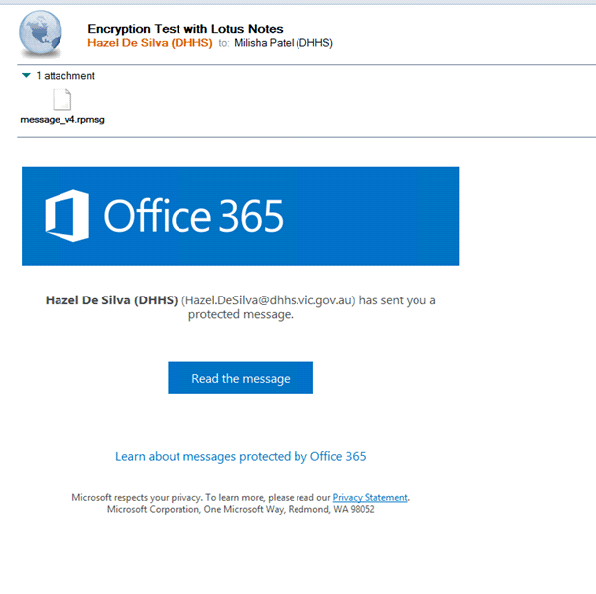
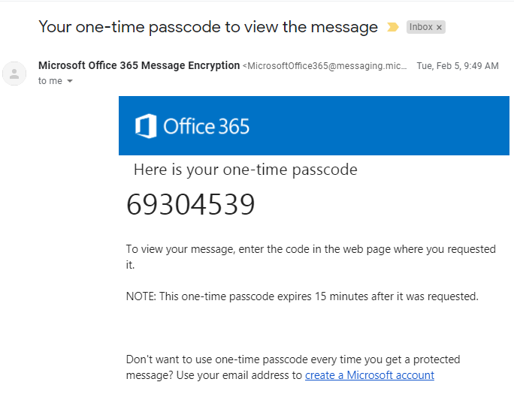
Receiving Encrypted Emails
Receiving an Encrypted email in a non-Microsoft email service (e.g. Lotus Notes)
You will receive an email containing an Office 365 window stating that a protected message has been sent to you
Click Read the Message to view the protected email
You will be prompted for authentication by either signing in to Microsoft Office OR with a one-time passcode
Choose sign in with a one-time passcode
An 8 digit code will be sent to you form MicrosoftOffice365@messaging.Microsoft.com
Enter the code to authenticate your account
1
3
5
6
2
4

Slide 8
Receiving Encrypted Emails
Receiving an Encrypted email in a non-Microsoft email service (e.g. Lotus Notes) continued
The Office 365 Message Encryption (OME) Portal opens the protected email message
All correspondence (Reply, Reply All, Forward) needs to occur within the OME Portal
Receiving a Do Not Forward email in OME Portal
Do Not Forward emails have the forward function disabled.
Should you wish to Reply or Reply All to a Do Not Forward email, you will be unable to add/remove any recipients to the To, CC or BCC fields.
Attempting to forward an email from a non-Microsoft service (e.g. Notes)
Forwarding functionality has only been disabled within the OME portal for Do Not Forward encrypted emails.
This means you will still have the ability to forward the email you received in Lotus Notes (or other non-Microsoft email services). However, new recipients will not be able to open the link to view the original email.
1
2

Slide 9
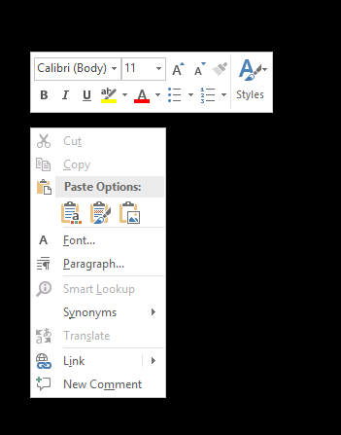
Receiving Attachments from Encrypted Emails
Do Not Forward Email Attachments
Attachments added to Do Not Forward emails cannot be copied, printed or forwarded. This restriction also includes attempting to take a screenshot of the document (e.g. by using the Snippet tool) or attempting to Print Screen the page.
Ensure you are aware of these restrictions when sending attachments using the Do Not Forward feature.
If you need to collaborate on a document with others, make sure to send a document link from SharePoint or TRIM rather than attaching the file.
Microsoft Office Products earlier than 2010
Recipients using Microsoft Office products released earlier than 2010 may not be able to open files attached to an encrypted email.
This is because Microsoft Office products released earlier than 2010 do not have the adds rights protection feature. These recipients will however be able to access the document/s using Microsoft Online products (e.g. Word Online, Excel Online, PowerPoint Online).

Slide 10
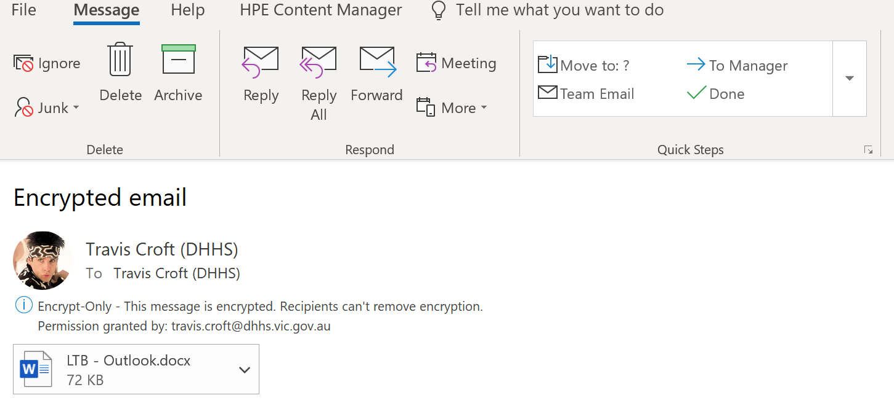
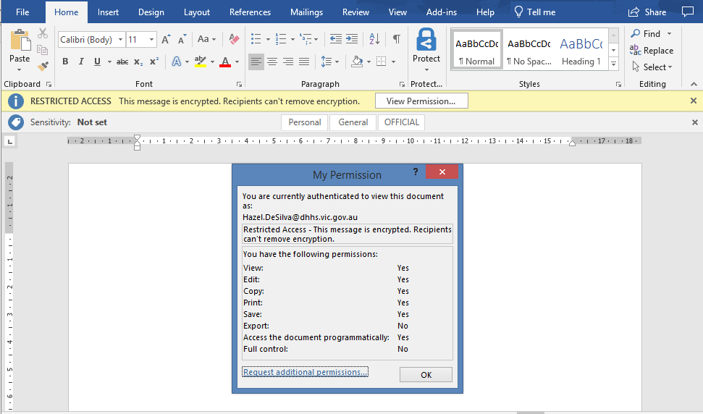
Receiving Attachments from Encrypted Emails
Receiving Attachments from Encrypted Emails
Download the attachment by double-clicking on the document in Outlook
The document will open in a Microsoft Office application, e.g. Word, Excel, PowerPoint
A banner appears on the document stating that access is restricted
Click View Permissions
A pop-up will appear stating the access you have to the document
If required, click Request additional permissions to request access to the document
Request Additional Permissions
Clicking “Request Additional Permissions” triggers an email to open for you to request added permissions from the document owner.
1
4
2
3
5
Pro tip: Attachments where collaboration is required; save the file into a SharePoint folder with the appropriate restrictions and send a document link in the encrypted email.
6

